Slide 1
Dimension Reduction
SCVIS – A VAE-based approach
Speaker: Jeff

Slide 2
Introduction
Paper: Interpretable Dimensionality Reduction of Single Cell Transcriptome Data with Deep Generative Models.

Slide 3
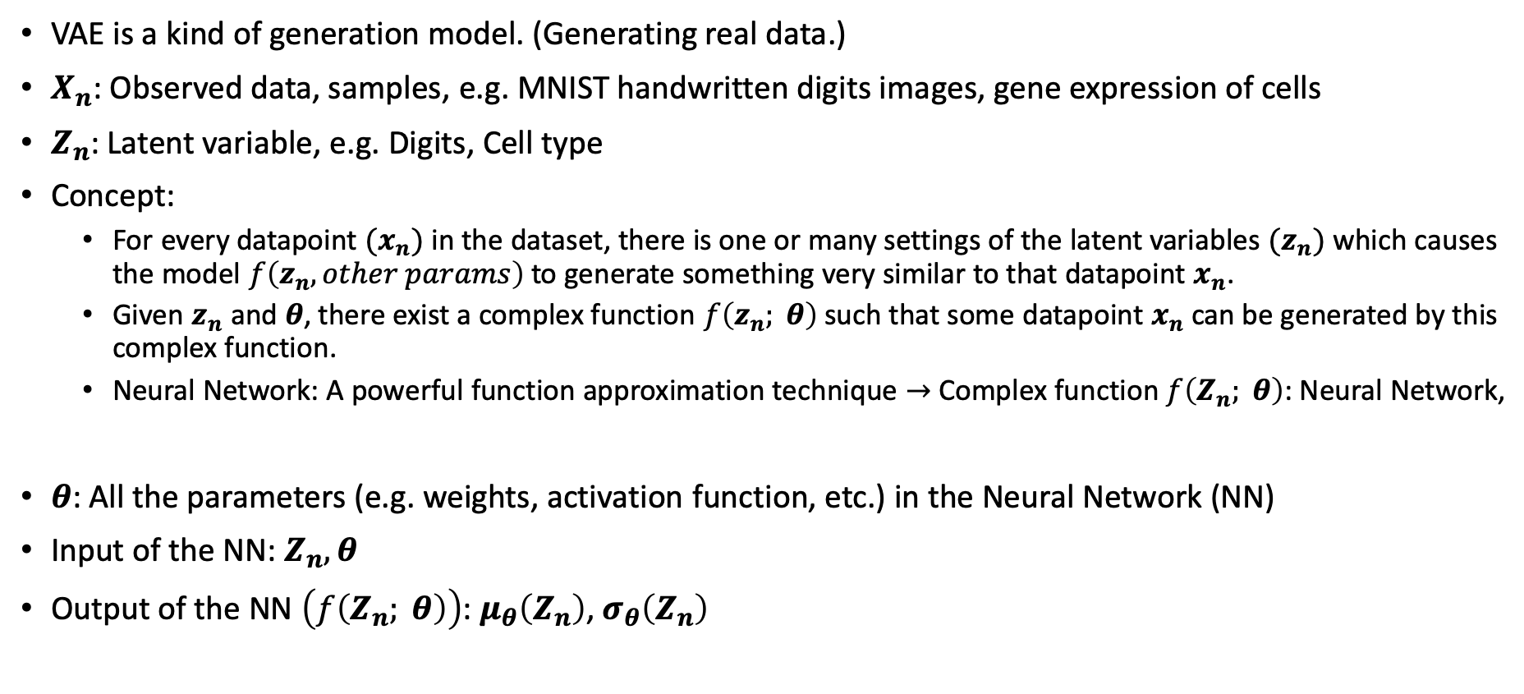
Variational Autoencoder (VAE)
VAE is a kind of generation model. (Generating real data.)
$X_{n}$: Observed data, samples, e.g. MNIST handwritten digits images, gene expression of cells
$Z_{n}$: Latent variable, e.g. Digits, Cell type
Concept:
For every datapoint ${(x}_{n})$ in the dataset, there is one or many settings of the latent variables $(z_{n})$ which causes the model $f\left(z_{n}, other params\right)$ to generate something very similar to that datapoint $x_{n}$.
Given $z_{n}$ and $θ$, there exist a complex function $f\left(z_{n}; θ\right)$ such that some datapoint $x_{n}$ can be generated by this complex function.
Neural Network: A powerful function approximation technique $→$Complex function $f\left(Z_{n}; θ\right)$: Neural Network,
$θ$: All the parameters (e.g. weights, activation function, etc.) in the Neural Network (NN)
Input of the NN: $Z_{n}, θ$
Output of the NN $\left(f\left(Z_{n}; θ\right)\right)$: $μ_{θ}\left(Z_{n}\right)$, $σ_{θ}\left(Z_{n}\right)$

Slide 4
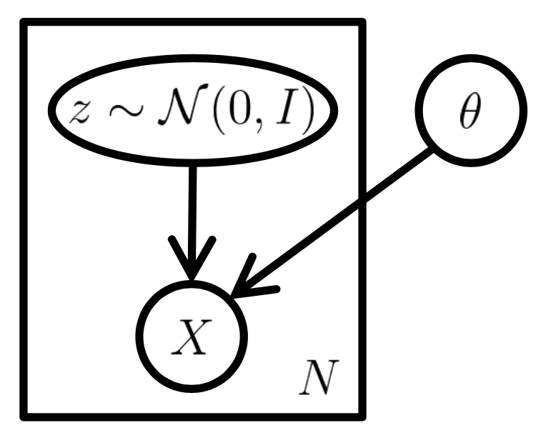
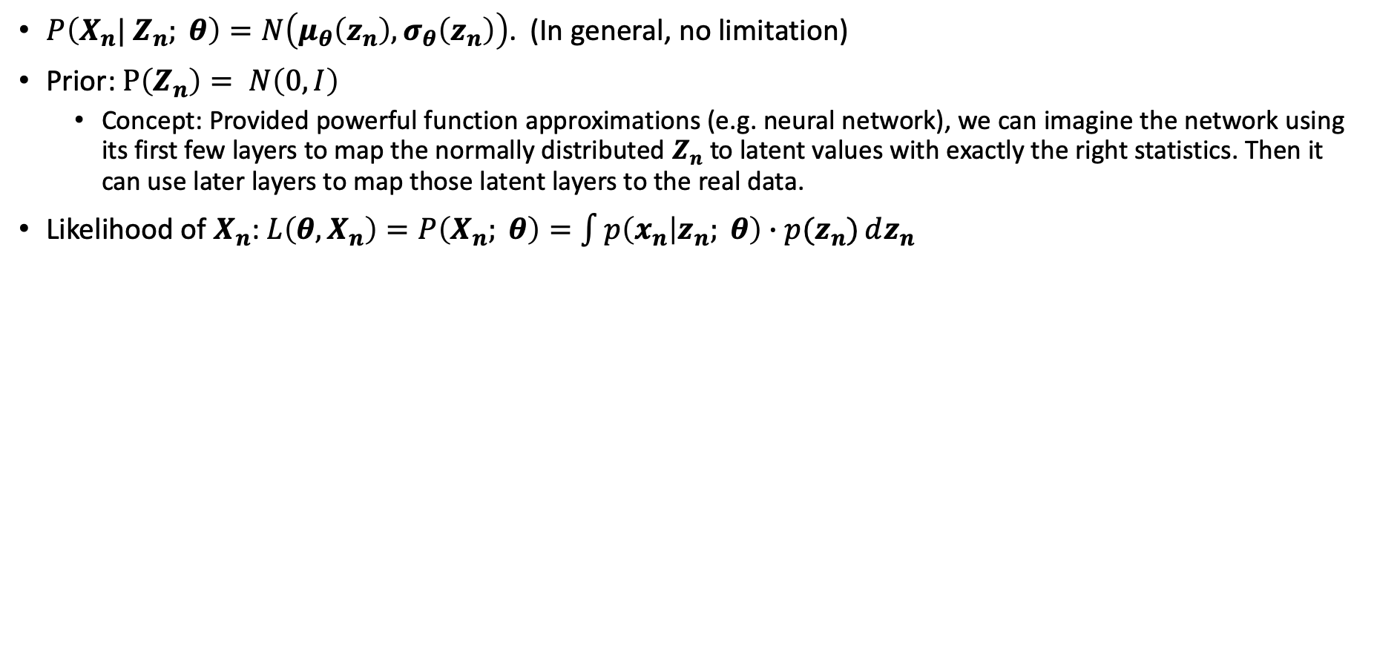
Variational Autoencoder (VAE)
$P\left(X_{n}| Z_{n}; θ\right)=N\left(μ_{θ}\left(z_{n}\right), σ_{θ}\left(z_{n}\right)\right)$. (In general, no limitation)
Prior: $P\left(Z_{n}\right)= N\left(0, I\right)$
Concept: Provided powerful function approximations (e.g. neural network), we can imagine the network using its first few layers to map the normally distributed $Z_{n}$ to latent values with exactly the right statistics. Then it can use later layers to map those latent layers to the real data.
Likelihood of $X_{n}$: $L\left(θ,X_{n}\right)=P\left(X_{n}; θ\right)=\int{p\left(x_{n} | z_{n}; θ\right)∙p(z_{n})}dz_{n}$

Slide 5
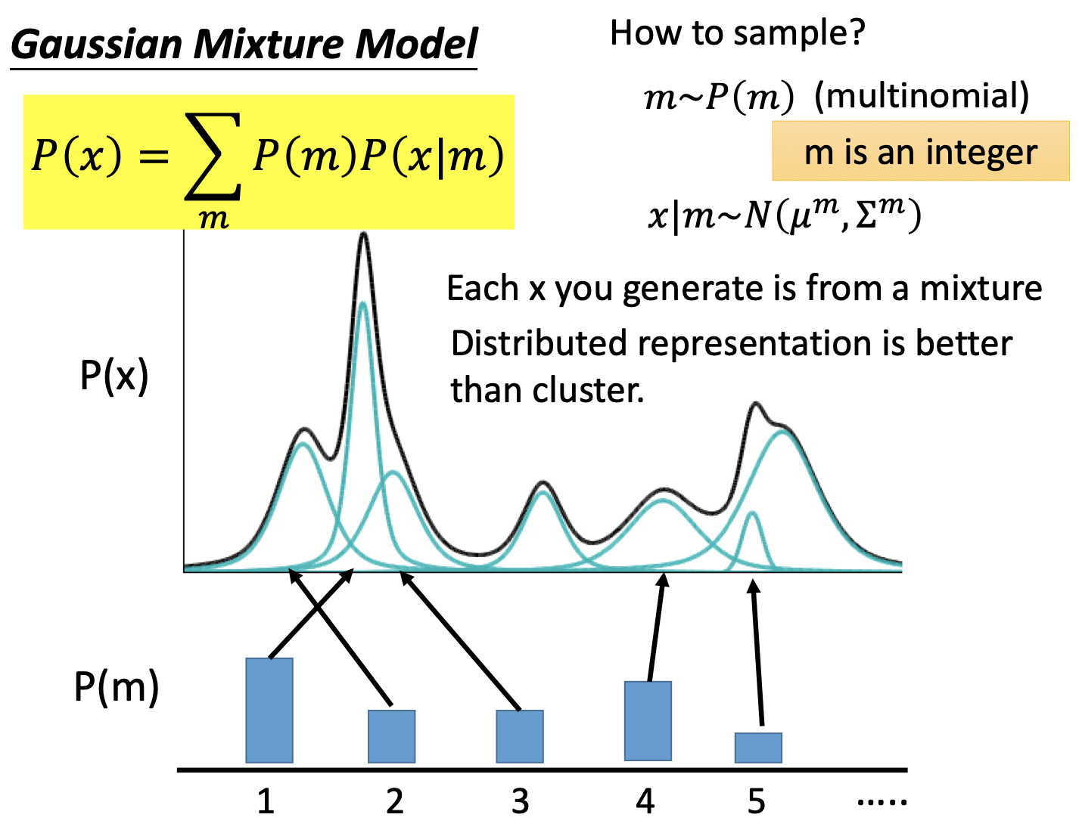
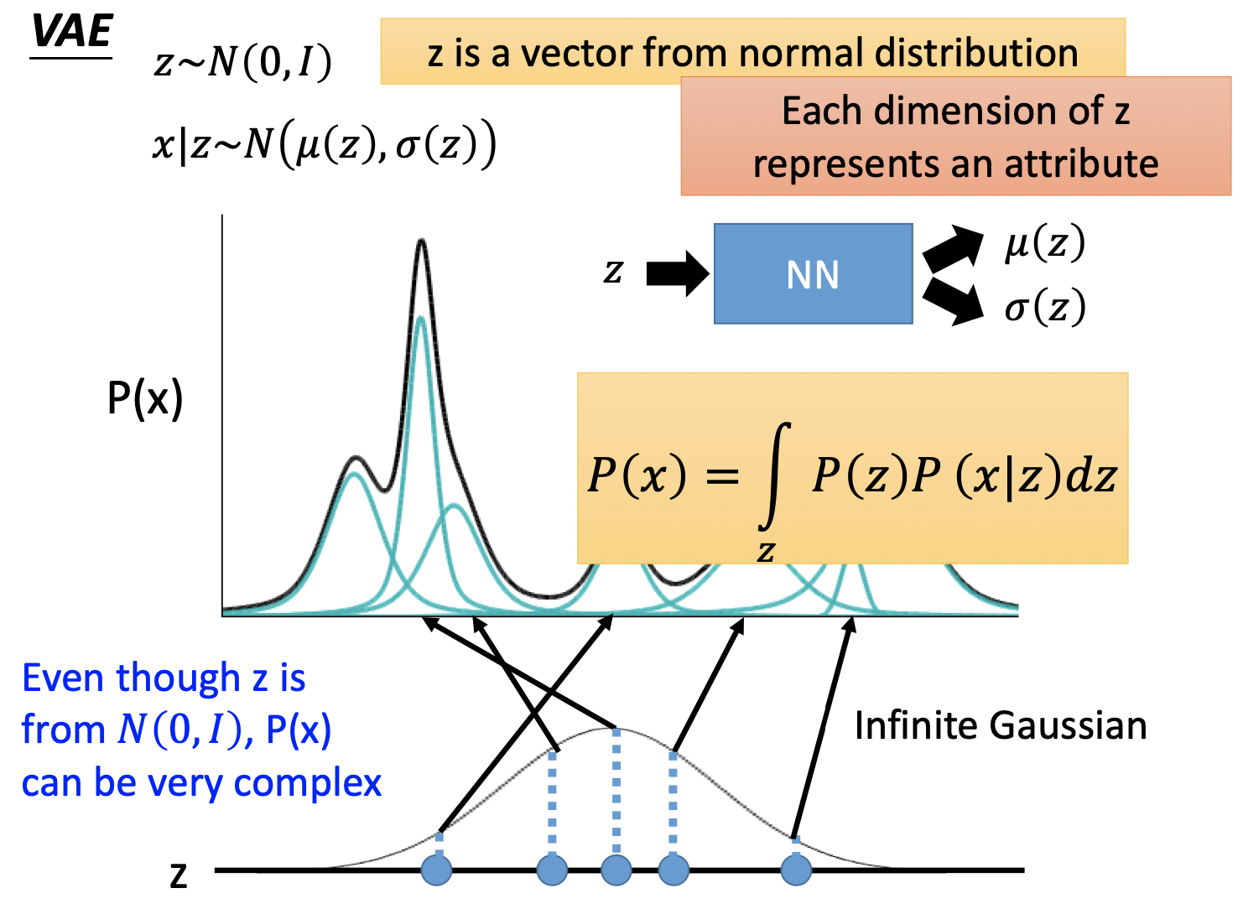
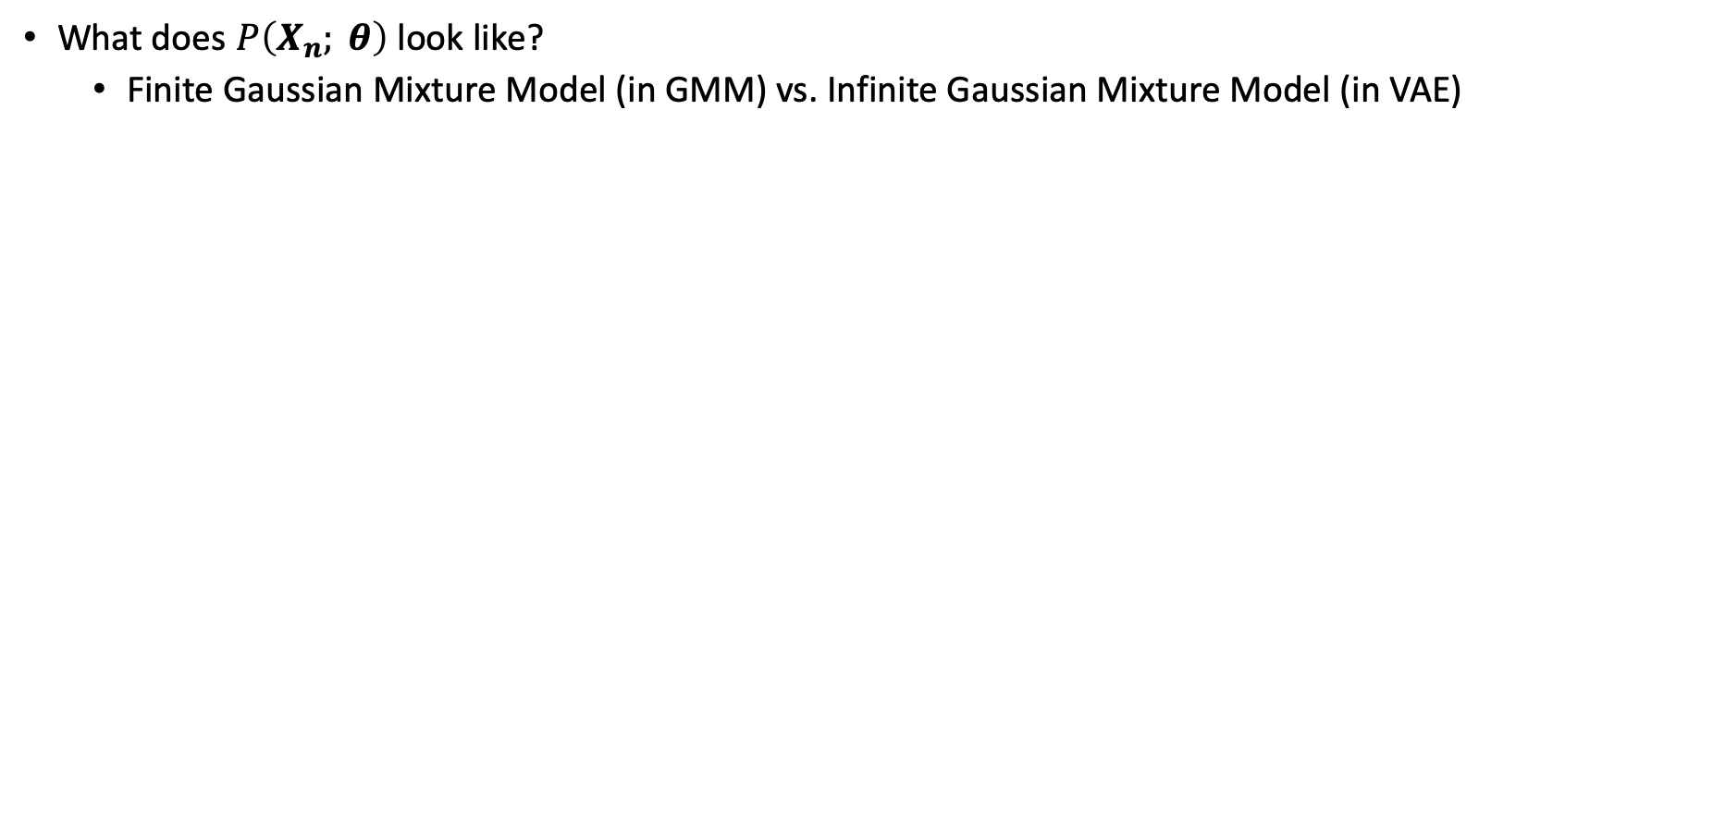
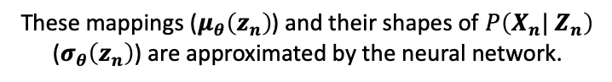

Variational Autoencoder (VAE)
What does $P\left(X_{n}; θ\right)$ look like?
Finite Gaussian Mixture Model (in GMM) vs. Infinite Gaussian Mixture Model (in VAE)
What if $P\left(m\right)$ is a continuous function?
These mappings ($μ_{θ}\left(z_{n}\right)$) and their shapes of $P\left(X_{n}| Z_{n}\right)$ ($σ_{θ}\left(z_{n}\right)$) are approximated by the neural network.

Slide 6
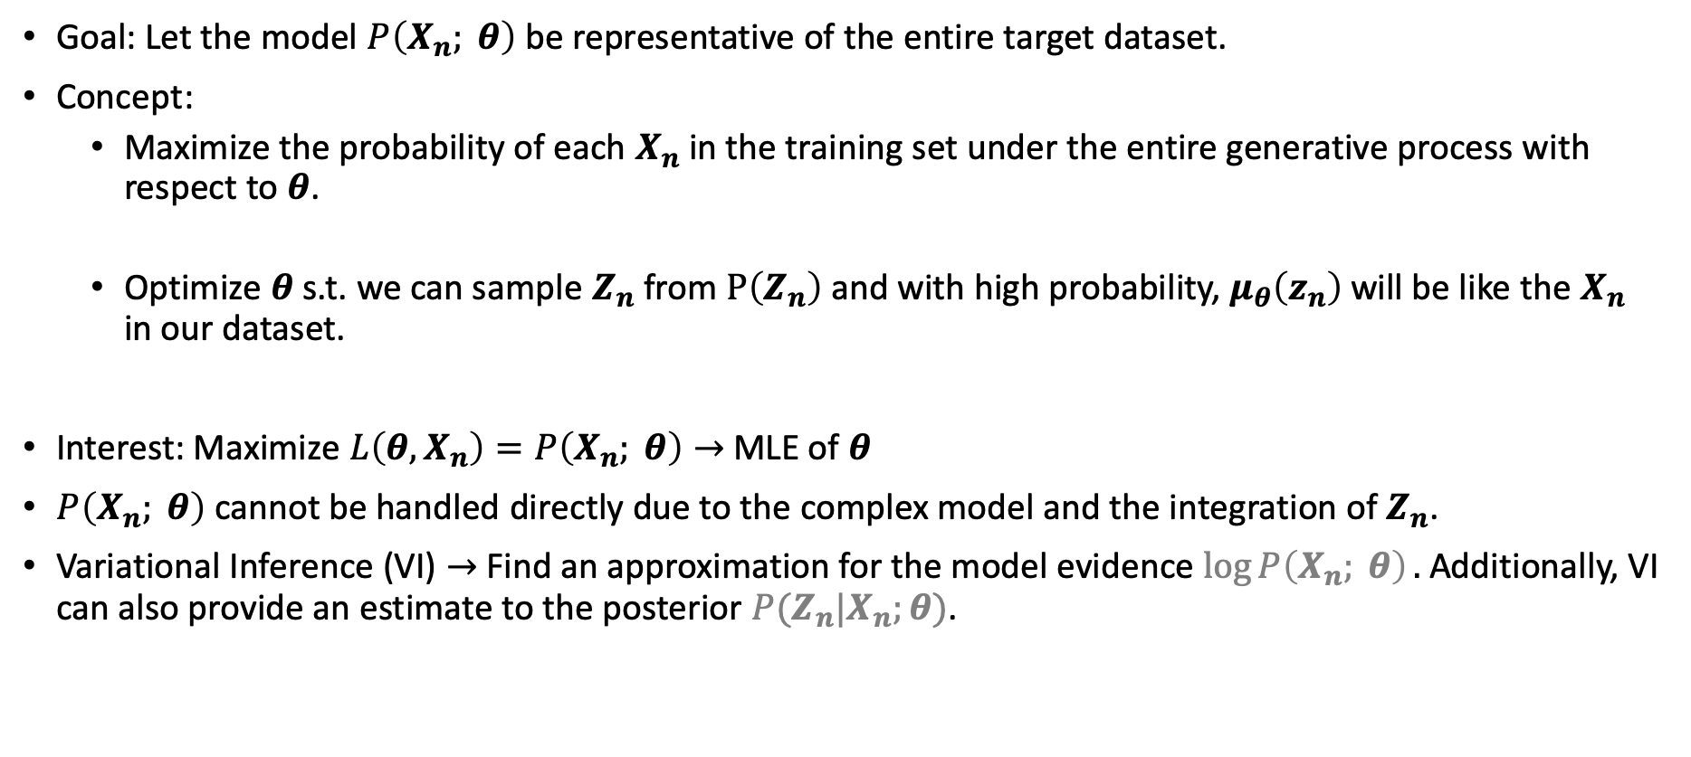
Variational Autoencoder (VAE)
Goal: Let the model $P\left(X_{n}; θ\right)$ be representative of the entire target dataset.
Concept:
Maximize the probability of each $X_{n}$ in the training set under the entire generative process with respect to $θ$.
Optimize $θ$ s.t. we can sample $Z_{n}$ from $P\left(Z_{n}\right)$ and with high probability, $μ_{θ}\left(z_{n}\right)$ will be like the $X_{n}$ in our dataset.
Interest: Maximize $L\left(θ,X_{n}\right)=P\left(X_{n}; θ\right)→$ MLE of $θ$
$P\left(X_{n}; θ\right)$ cannot be handled directly due to the complex model and the integration of $Z_{n}$.
Variational Inference (VI) $→$ Find an approximation for the model evidence $\log{P\left(X_{n}; θ\right)}.$ Additionally, VI can also provide an estimate to the posterior $P(Z_{n}|X_{n};θ)$.

Slide 7
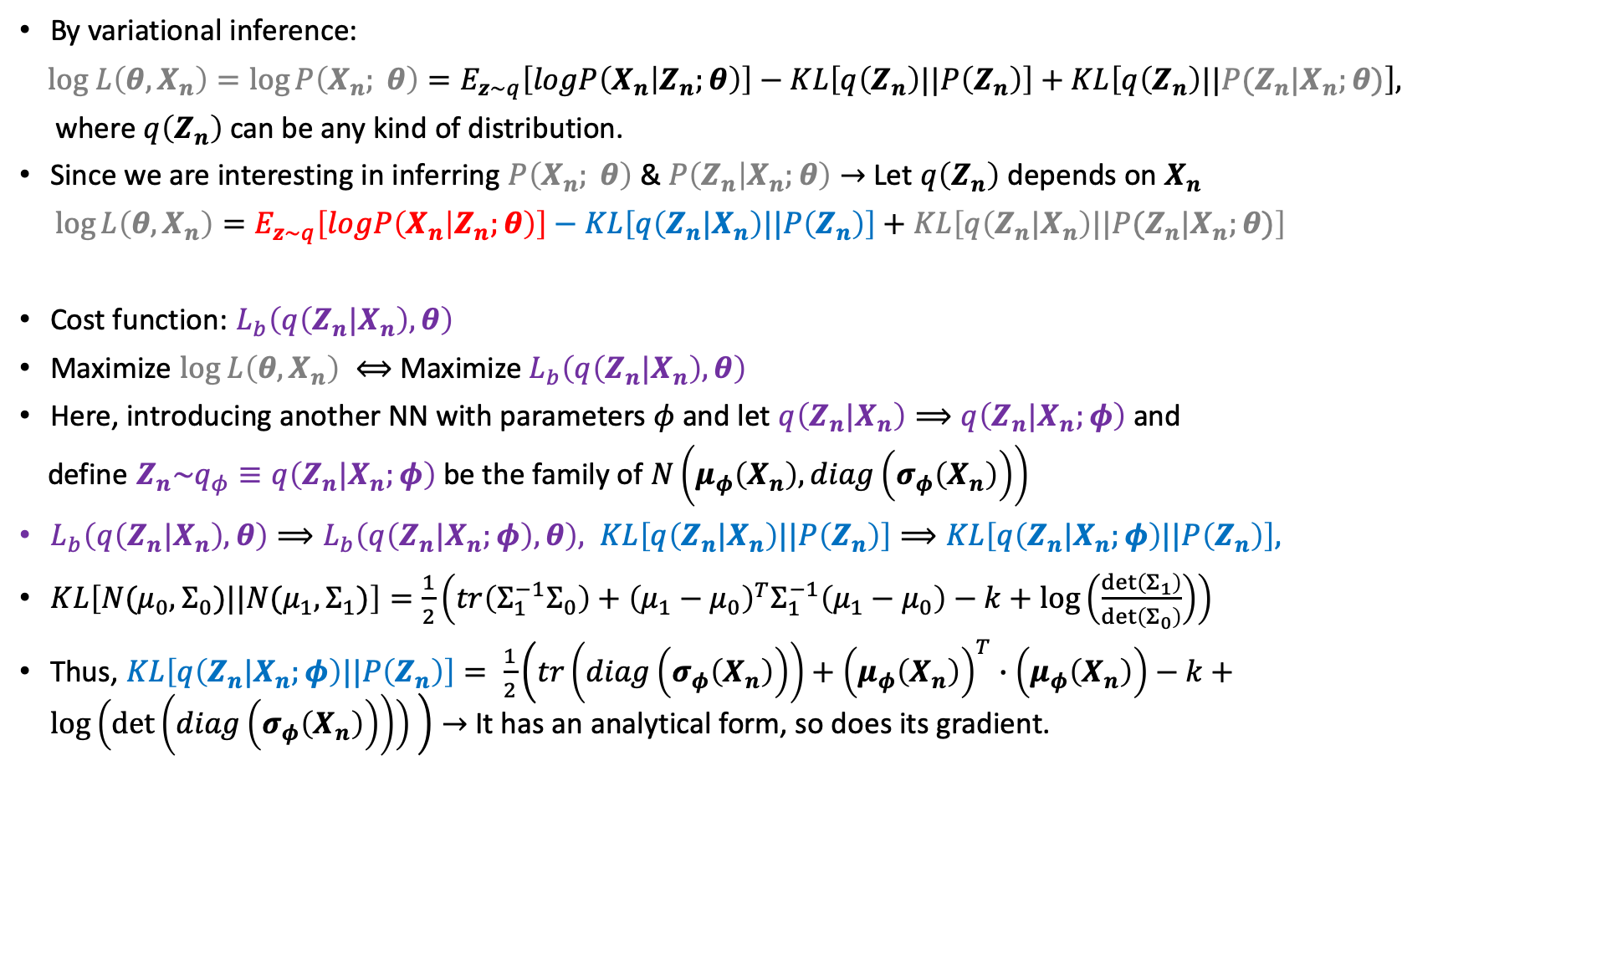
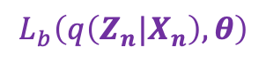
Variational Autoencoder (VAE)
By variational inference:
$log L\left(θ,X_{n}\right)=\log{P\left(X_{n}; θ\right)}=E_{z\sim q}\left[logP\left(X_{n} | Z_{n};θ\right)\right]−KL\left[q\left(Z_{n}\right)||P\left(Z_{n}\right)\right]+KL\left[q\left(Z_{n}\right)||P(Z_{n}|X_{n};θ)\right],$
where $q\left(Z_{n}\right)$ can be any kind of distribution.
Since we are interesting in inferring $P\left(X_{n}; θ\right)$ & $P\left(Z_{n} | X_{n};θ\right)→$ Let $q\left(Z_{n}\right)$ depends on $X_{n}$
$\log{L\left(θ,X_{n}\right)}=E_{z\sim q}\left[logP\left(X_{n} | Z_{n};θ\right)\right]−KL\left[q\left(Z_{n}|X_{n}\right)||P\left(Z_{n}\right)\right]+KL\left[q\left(Z_{n}|X_{n}\right)||P(Z_{n}|X_{n};θ)\right]$
Cost function: $L_{b}\left(q\left(Z_{n}|X_{n}\right), θ\right)$
Maximize $log L\left(θ,X_{n}\right) ⟺$ Maximize $L_{b}\left(q\left(Z_{n}|X_{n}\right), θ\right)$
Here, introducing another NN with parameters $φ$ and let $q\left(Z_{n}|X_{n}\right)⟹q\left(Z_{n}|X_{n};φ\right)$ and
define $Z_{n}\sim q_{φ}≡q\left(Z_{n}|X_{n};φ\right)$ be the family of $N\left(μ_{φ}\left(X_{n}\right), diag\left(σ_{φ}\left(X_{n}\right)\right)\right)$
$L_{b}\left(q\left(Z_{n}|X_{n}\right), θ\right)⟹L_{b}\left(q\left(Z_{n}|X_{n};φ\right), θ\right), KL\left[q\left(Z_{n}|X_{n}\right)||P\left(Z_{n}\right)\right]⟹KL\left[q\left(Z_{n}|X_{n};φ\right)||P\left(Z_{n}\right)\right],$
$KL\left[N(μ_{0}, Σ_{0})||N(μ_{1}, Σ_{1})\right]=\frac{1}{2}\left(tr\left(Σ_{1}^{−1}Σ_{0}\right)+{\left(μ_{1}−μ_{0}\right)}^{T}Σ_{1}^{−1}\left(μ_{1}−μ_{0}\right)−k+\log\left(\frac{\det\left(Σ_{1}\right)}{\det\left(Σ_{0}\right)}\right)\right)$
Thus, $KL\left[q\left(Z_{n}|X_{n};φ\right)||P\left(Z_{n}\right)\right]= \frac{1}{2}\left(tr\left(diag\left(σ_{φ}\left(X_{n}\right)\right)\right)+{\left(μ_{φ}\left(X_{n}\right)\right)}^{T}∙\left(μ_{φ}\left(X_{n}\right)\right)−k+\log\left(\det\left(diag\left(σ_{φ}\left(X_{n}\right)\right)\right)\right) \right)→$ It has an analytical form, so does its gradient.
$$L_{b}\left(q\left(Z_{n}|X_{n}\right), θ\right)$$

Slide 8
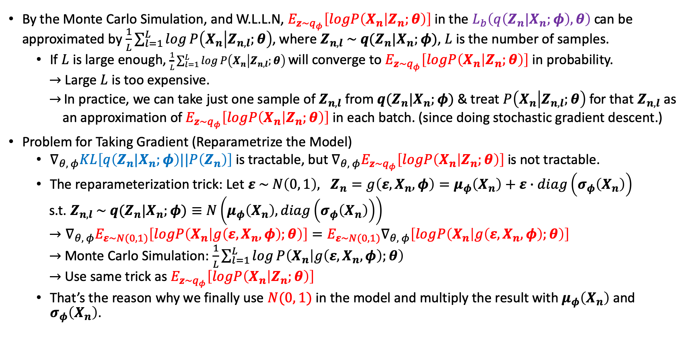
Variational Autoencoder (VAE)
By the Monte Carlo Simulation, and W.L.L.N, $E_{z\sim q_{φ}}\left[logP\left(X_{n} | Z_{n};θ\right)\right]$ in the $L_{b}\left(q\left(Z_{n}|X_{n};φ\right), θ\right)$ can be approximated by $\frac{1}{L}\sum_{l=1}^{L}{log}P\left(X_{n} | Z_{n, l};θ\right)$, where $Z_{n, l} \sim q(Z_{n}|X_{n};φ)$, $L$ is the number of samples.
If $L$ is large enough, $\frac{1}{L}\sum_{l=1}^{L}{log}P\left(X_{n} | Z_{n, l};θ\right)$ will converge to $E_{z\sim q_{φ}}\left[logP\left(X_{n} | Z_{n};θ\right)\right]$ in probability.
$→$Large $L$ is too expensive.
$→$ In practice, we can take just one sample of $Z_{n, l}$ from $q(Z_{n}|X_{n};φ)$ & treat $P\left(X_{n} | Z_{n, l};θ\right)$ for that $Z_{n, l}$ as
an approximation of $E_{z\sim q_{φ}}\left[logP\left(X_{n} | Z_{n};θ\right)\right]$ in each batch. (since doing stochastic gradient descent.)
Problem for Taking Gradient (Reparametrize the Model)
$∇_{θ, φ}KL\left[q\left(Z_{n}|X_{n};φ\right)||P\left(Z_{n}\right)\right]$ is tractable, but ${∇_{θ, φ}E}_{z\sim q_{φ}}\left[logP\left(X_{n} | Z_{n};θ\right)\right]$ is not tractable.
The reparameterization trick: Let $ε \sim N\left(0, 1\right), Z_{n}=g\left(ε,X_{n},φ\right)=μ_{φ}\left(X_{n}\right)+ε∙diag\left(σ_{φ}\left(X_{n}\right)\right)$
s.t. $Z_{n, l} \sim q(Z_{n}|X_{n};φ)≡N\left(μ_{φ}\left(X_{n}\right), diag\left(σ_{φ}\left(X_{n}\right)\right)\right)$
$→∇_{θ, φ}E_{ε\sim N(0, 1)}\left[logP\left(X_{n} | g\left(ε,X_{n},φ\right);θ\right)\right]=E_{ε\sim N(0, 1)}∇_{θ, φ}\left[logP\left(X_{n} | g\left(ε,X_{n},φ\right);θ\right)\right]$
$→$ Monte Carlo Simulation: $\frac{1}{L}\sum_{l=1}^{L}{log}P\left(X_{n} | g\left(ε,X_{n},φ\right);θ\right)$
$→$ Use same trick as $E_{z\sim q_{φ}}\left[logP\left(X_{n} | Z_{n};θ\right)\right]$
That’s the reason why we finally use $N(0, 1)$ in the model and multiply the result with $μ_{φ}\left(X_{n}\right)$and $σ_{φ}\left(X_{n}\right)$.

Slide 9
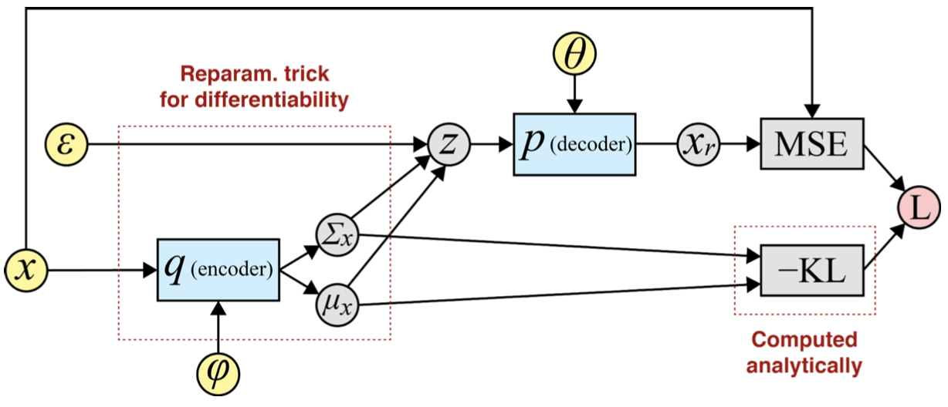
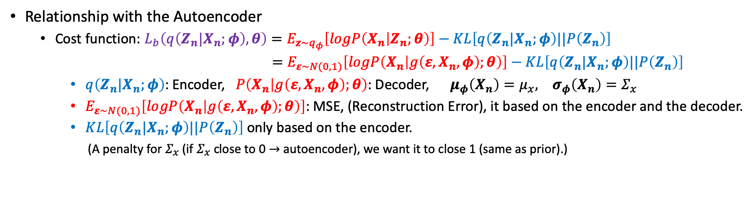
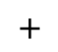

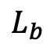
Variational Autoencoder (VAE)
Relationship with the Autoencoder
Cost function: $L_{b}\left(q\left(Z_{n}|X_{n};φ\right), θ\right)=E_{z\sim q_{φ}}\left[logP\left(X_{n} | Z_{n};θ\right)\right]−KL\left[q\left(Z_{n}|X_{n};φ\right)||P\left(Z_{n}\right)\right]$
$=E_{ε\sim N(0, 1)}\left[logP\left(X_{n} | g\left(ε,X_{n},φ\right);θ\right)\right]−KL\left[q\left(Z_{n}|X_{n};φ\right)||P\left(Z_{n}\right)\right]$
$q\left(Z_{n}|X_{n};φ\right)$: Encoder, $P\left(X_{n} | g\left(ε,X_{n},φ\right);θ\right)$: Decoder, $μ_{φ}\left(X_{n}\right)=μ_{x}, σ_{φ}\left(X_{n}\right)=Σ_{x}$
$E_{ε\sim N(0, 1)}\left[logP\left(X_{n} | g\left(ε,X_{n},φ\right);θ\right)\right]$: MSE, (Reconstruction Error), it based on the encoder and the decoder.
$KL\left[q\left(Z_{n}|X_{n};φ\right)||P\left(Z_{n}\right)\right]$ only based on the encoder.
(A penalty for $Σ_{x}$ (if $Σ_{x}$ close to 0 $→$ autoencoder), we want it to close 1 (same as prior).)
$$∗$$
$$+$$
$$L_{b}$$

Slide 10
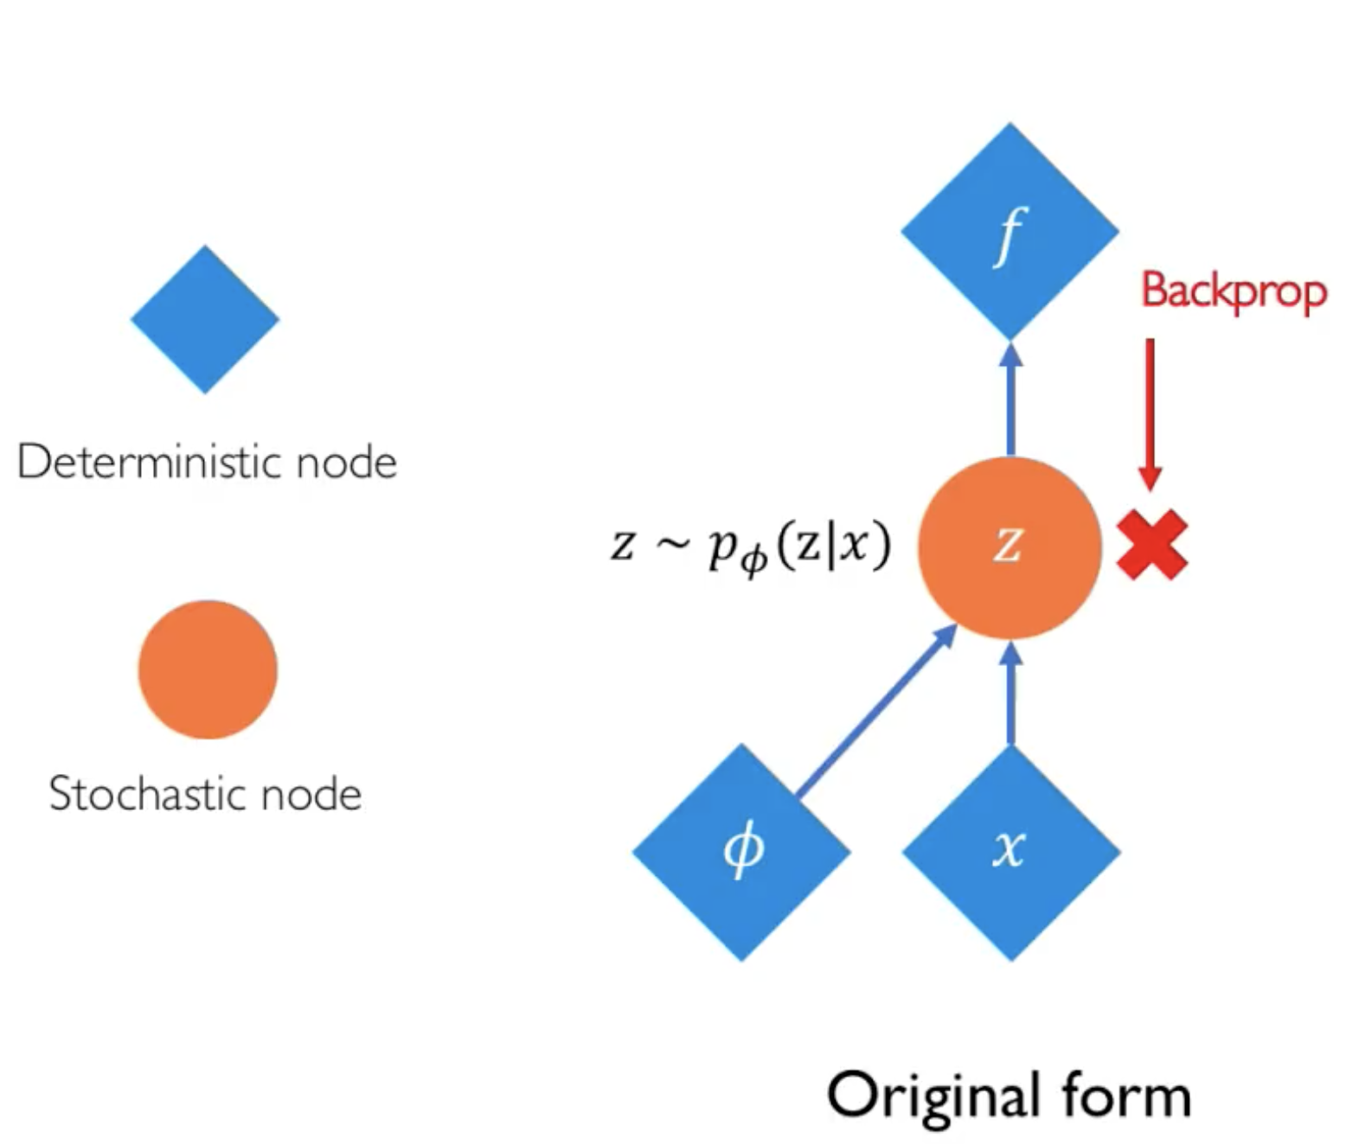
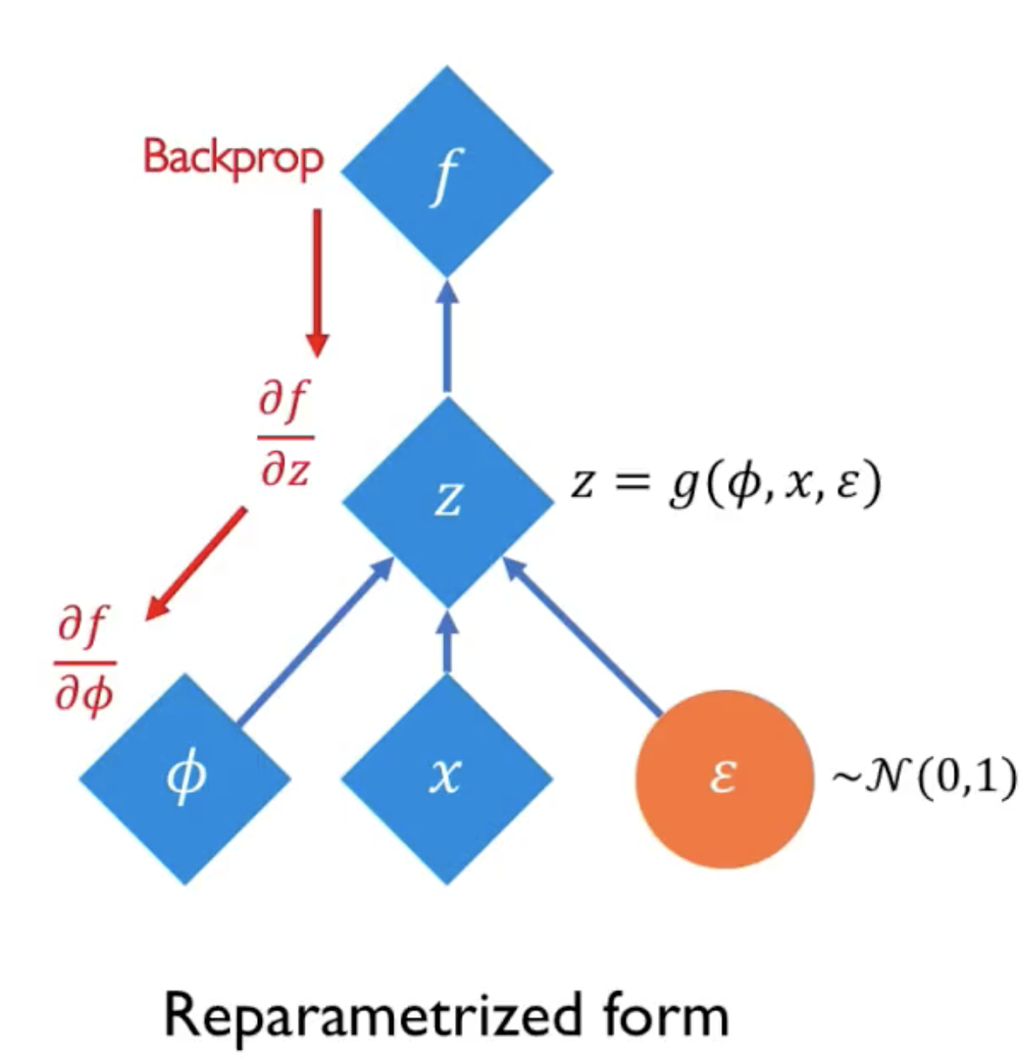
Variational Autoencoder (VAE)
Graphical Illustration for the Reparametrized Trick

Slide 11
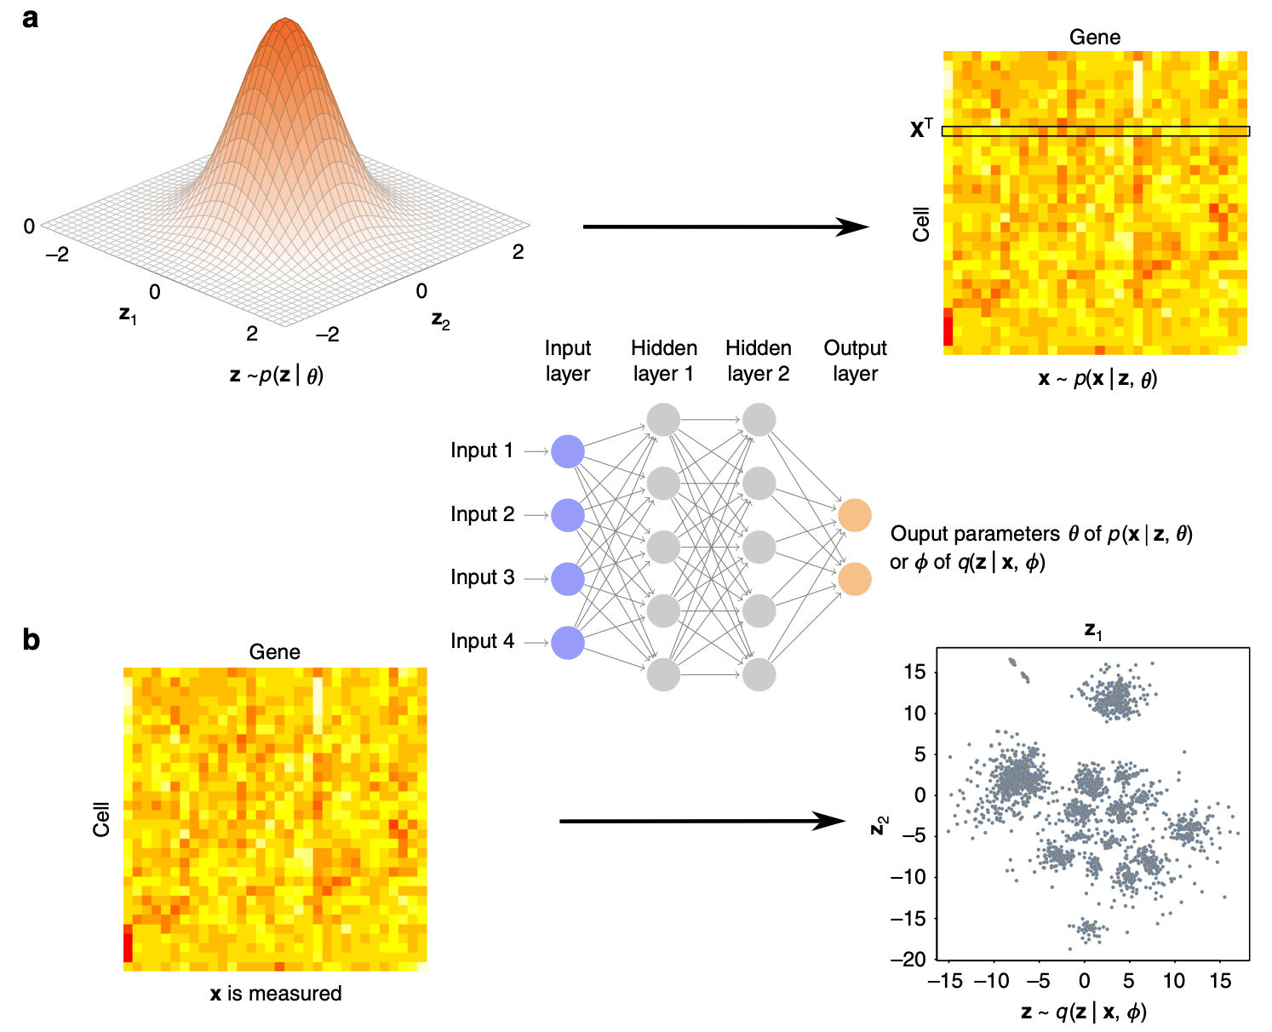
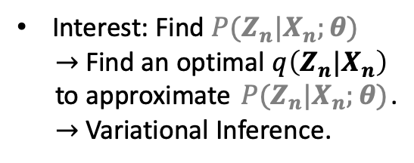
SCVIS
Interest: Find $P(Z_{n}|X_{n};θ)$
$→$ Find an optimal $q\left(Z_{n}|X_{n}\right)$
to approximate $P(Z_{n}|X_{n};θ)$.
$→$ Variational Inference.

Slide 12
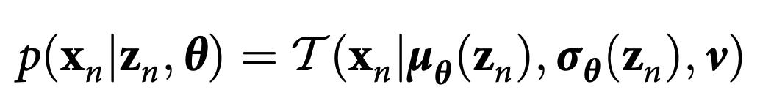
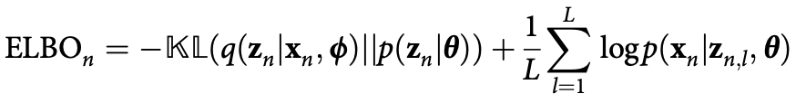
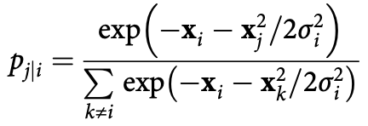
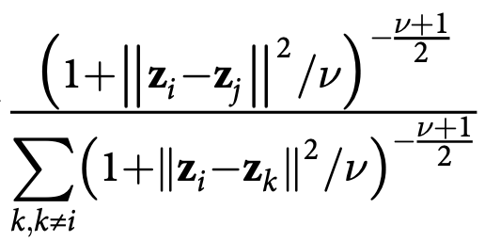
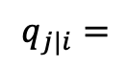
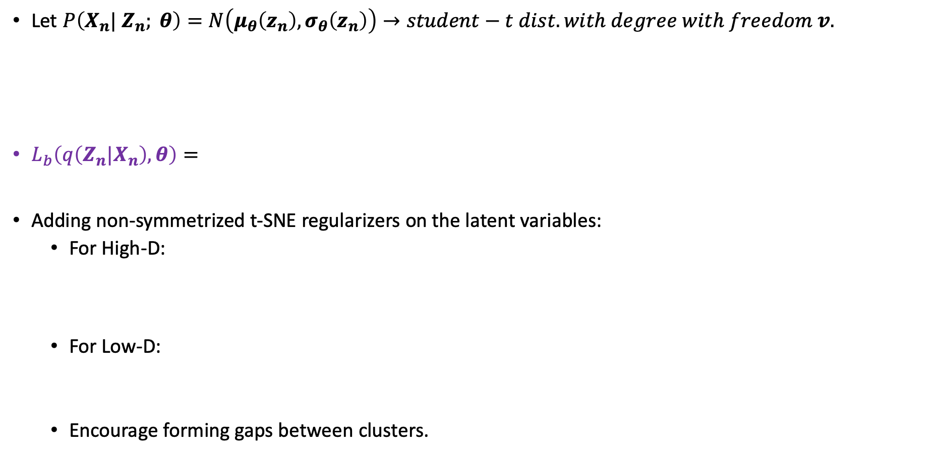
SCVIS
Let $P\left(X_{n}| Z_{n}; θ\right)=N\left(μ_{θ}\left(z_{n}\right), σ_{θ}\left(z_{n}\right)\right)→student−t dist. with degree with freedom v.$
$L_{b}\left(q\left(Z_{n}|X_{n}\right), θ\right)=$
Adding non-symmetrized t-SNE regularizers on the latent variables:
For High-D:
For Low-D:
Encourage forming gaps between clusters.
Prevent overfitting.
$$q_{j|i}=$$

Slide 13
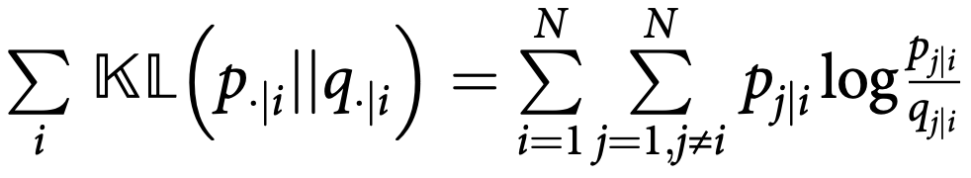
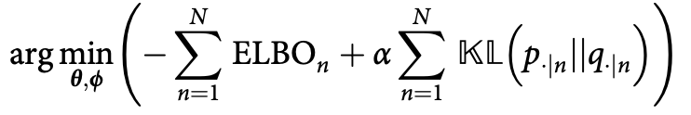
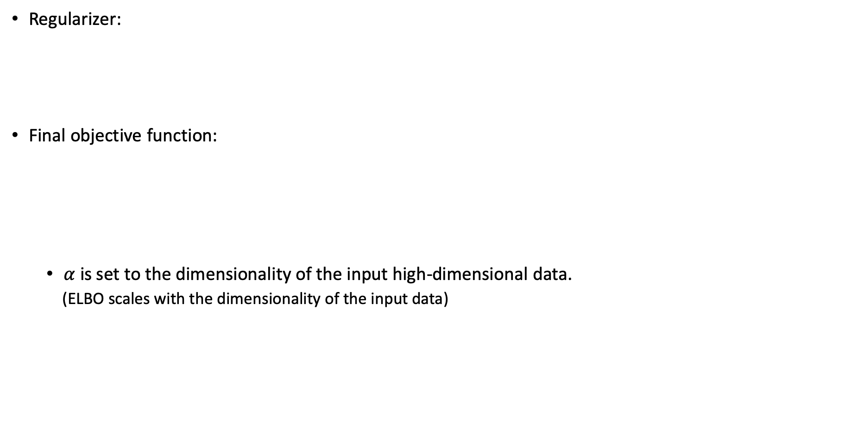
SCVIS
Regularizer:
Final objective function:
$α$ is set to the dimensionality of the input high-dimensional data.
(ELBO scales with the dimensionality of the input data)

Slide 14
SCVIS
Other parameters settings
Variational approximation NN hidden layers: 3 (128, 64, 32 hidden units for each layer.)
Model NN hidden layers: 5 (32, 32, 32, 64, 128 hidden units for each layer.)
Activation function: exponential linear unit (speed up the convergence of optimization).
L2 regularizer of 0.001 on the weights of the neural networks (prevent overfitting.)
Mini-batch size: 512 (cells) (for controlling the time complexity of t-SNE computation.)
Adam stochastic gradient descent with learning rate: 0.01.
Run optimization for 500 epochs for each dataset with at least 3000 iterations.
For large dataset, running a maximum of 30000 iteration or two epochs.

Slide 15
Simulation

Slide 16
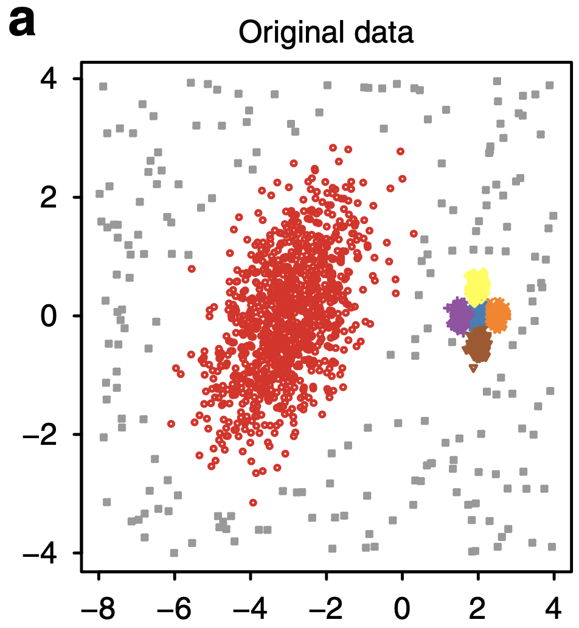
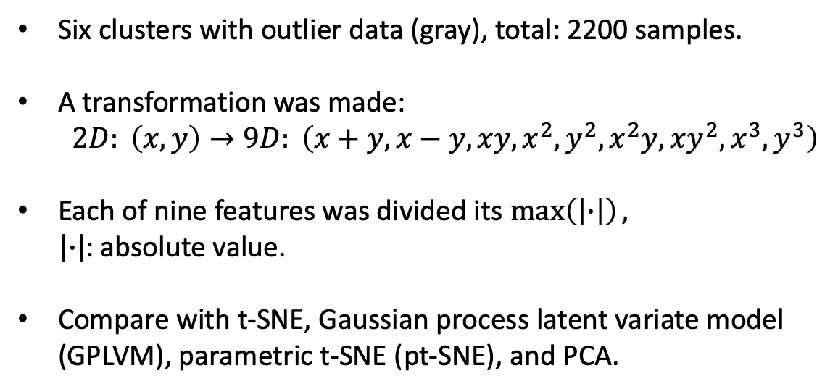
Simulation
Simulated data
200 outliers
Six clusters with outlier data (gray), total: 2200 samples.
A transformation was made:
$$2D: \left(x, y\right)→9D: \left(x+y, x−y, xy, x^{2}, y^{2},x^{2}y, xy^{2}, x^{3}, y^{3}\right)$$
Each of nine features was divided its $\max\left(\left|∙\right|\right),$
$\left|∙\right|$: absolute value.
Compare with t-SNE, Gaussian process latent variate model (GPLVM), parametric t-SNE (pt-SNE), and PCA.
200
1000
200
200
200
200

Slide 17
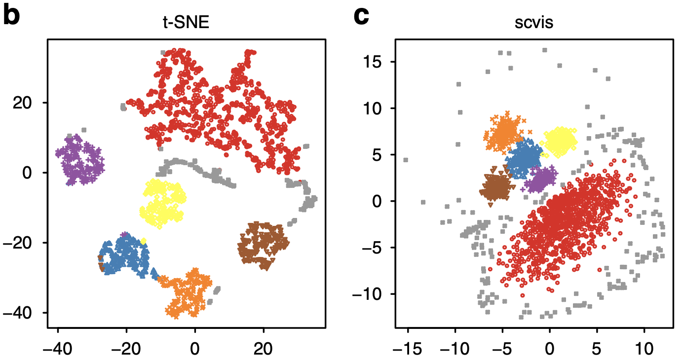
Simulation
Performance
t-SNE is challenging to infer the overall layout of the six clusters.
(Also, the global structure is not reliable.)
t-SNE put the outliers data (gray) into several compact clusters.
SCVIS preserved the overall structure of the original data.
(The relative positions of the clusters were also preserved.)
SCVIS let the outliers data (gray) surround the genuine clusters as the originally untransformed data.

Slide 18
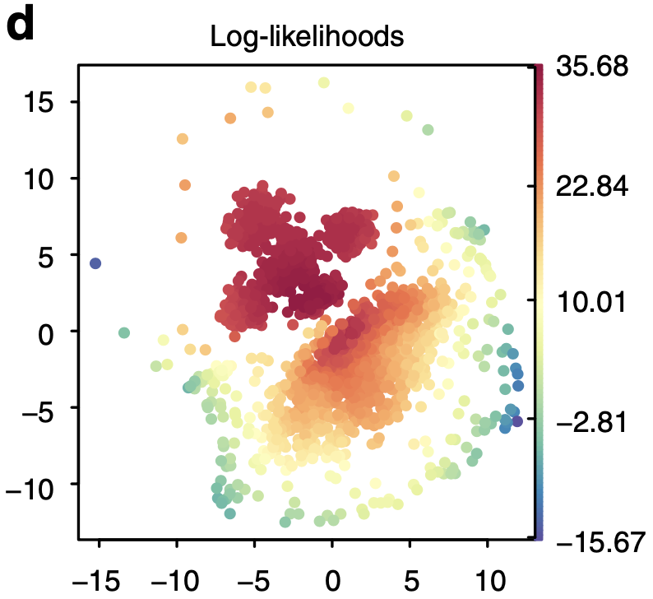
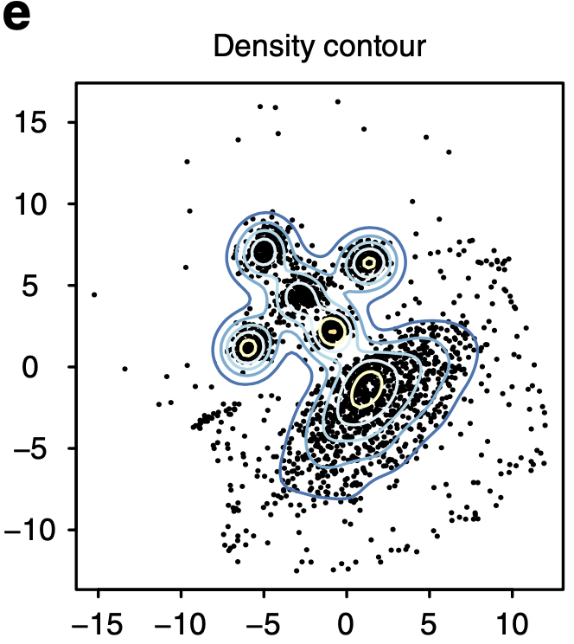
Simulation
Performance
Due to the use of generating model, SCVIS provide a way to quantify the uncertainty of the low-dimensional mapping by its log-likelihood.
SCVIS put most of its modeling power to model the five compact clusters, while the outliers have lower log-likelihood.

Slide 19
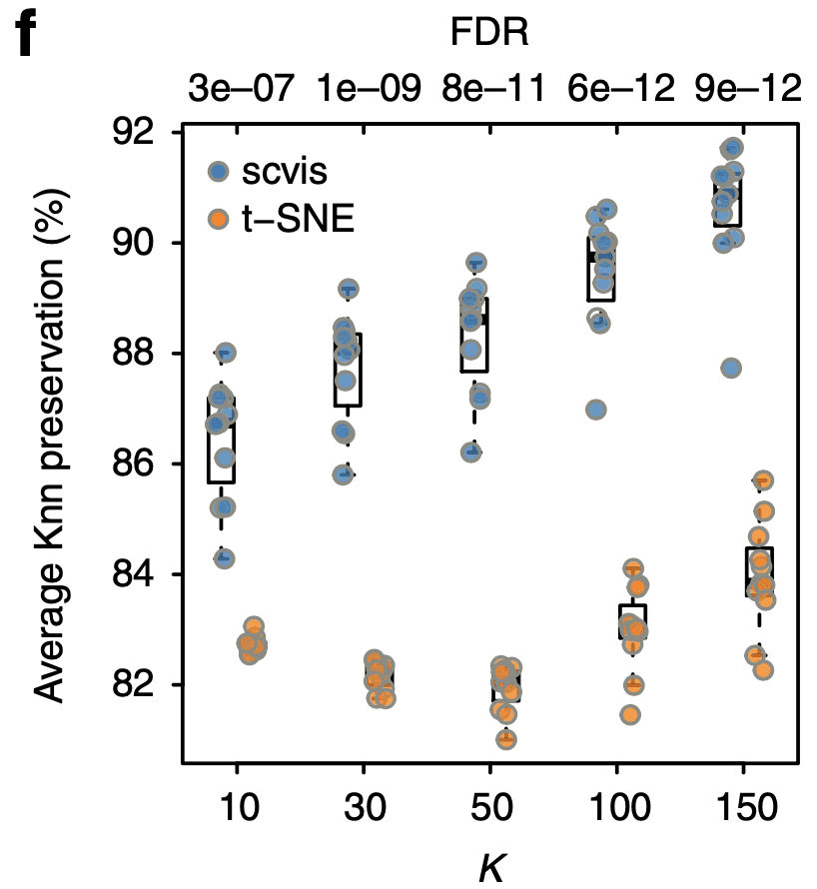
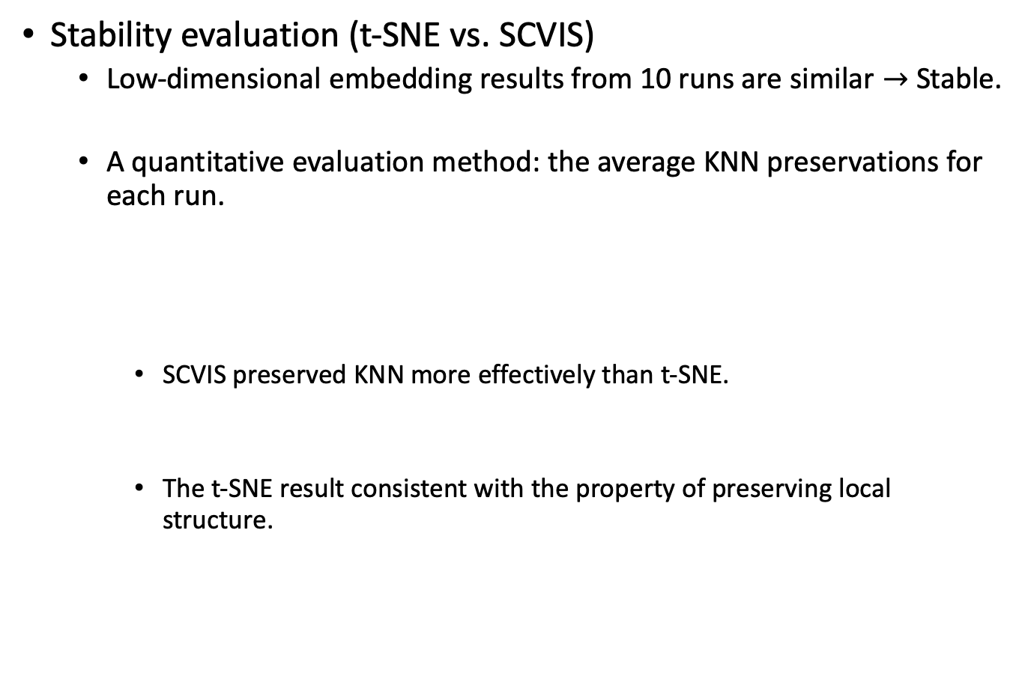
Simulation
Stability evaluation (t-SNE vs. SCVIS)
Low-dimensional embedding results from 10 runs are similar $→$ Stable.
A quantitative evaluation method: the average KNN preservations for each run.
SCVIS preserved KNN more effectively than t-SNE.
The t-SNE result consistent with the property of preserving local structure.

Slide 20
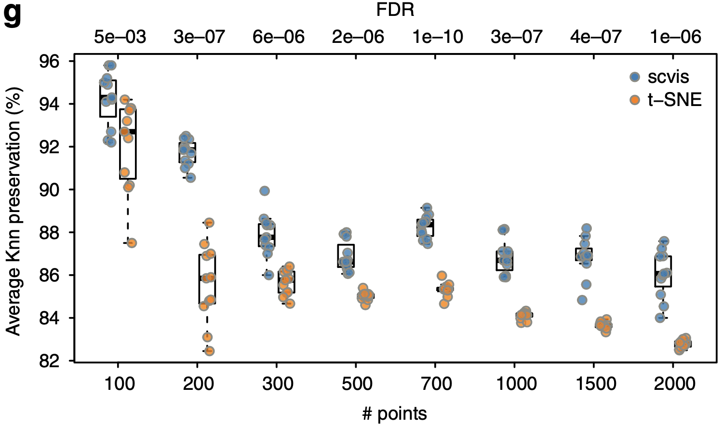
Simulation
Small datasets evaluation (t-SNE vs. SCVIS)
Data is sampled from the original simulation dataset.
Sample size: 100, 200, 300, 500, 700, 1000, 1500, 2000
Evaluation: KNN with K = 10
Compare with t-SNE, SCVIS performs very well on all the subsampled data. (preserved much of the structure of the data)

Slide 21
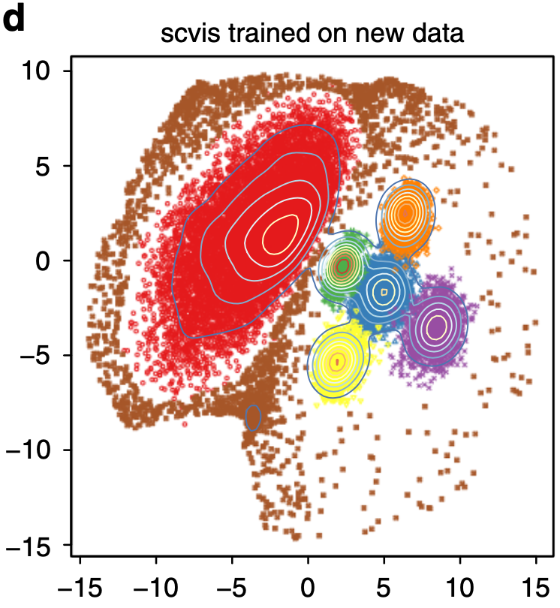
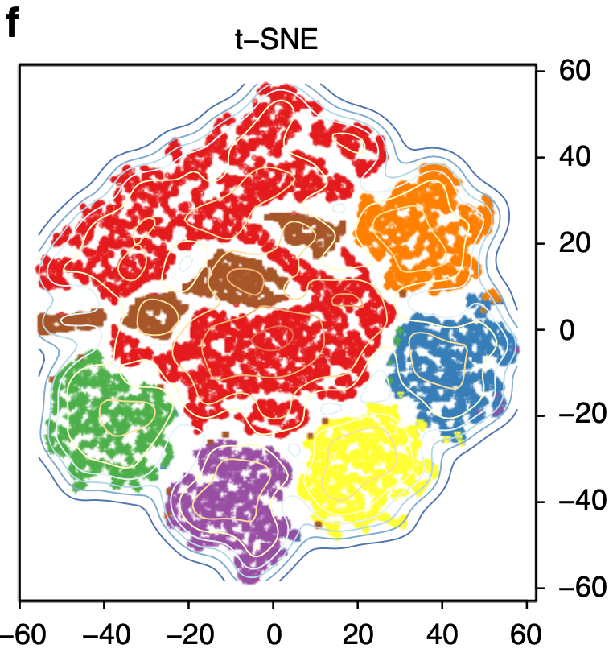
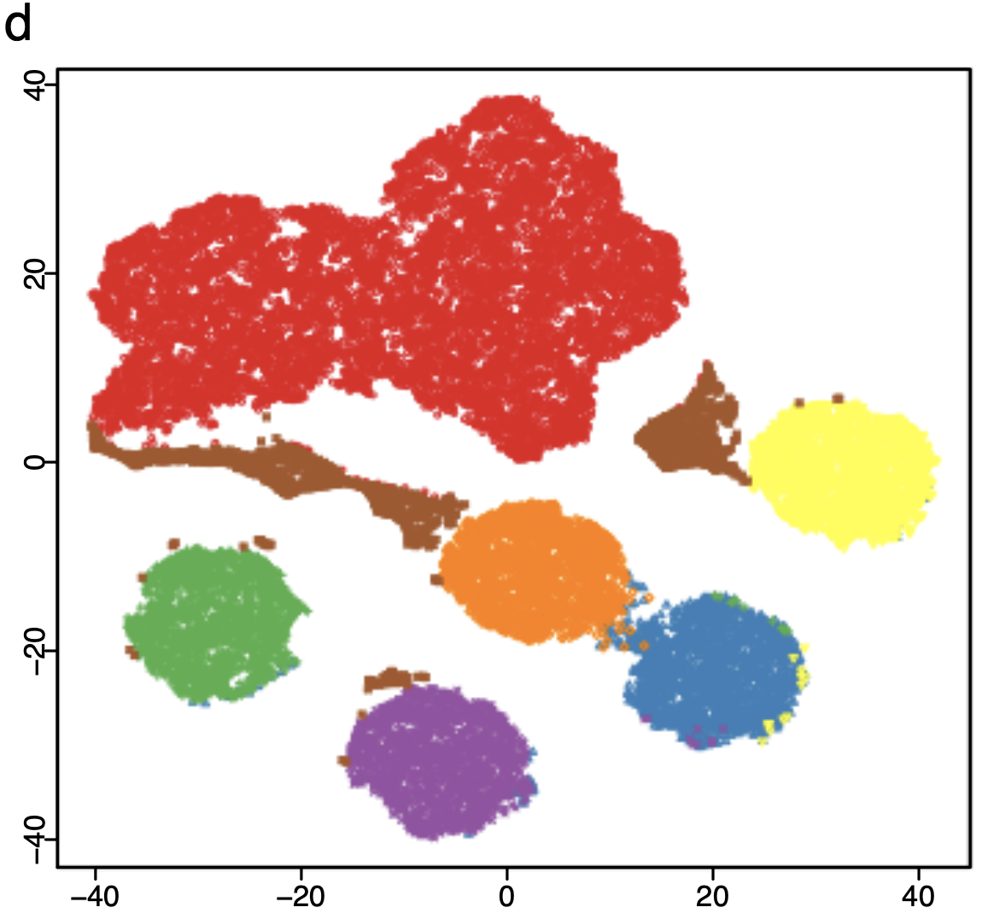
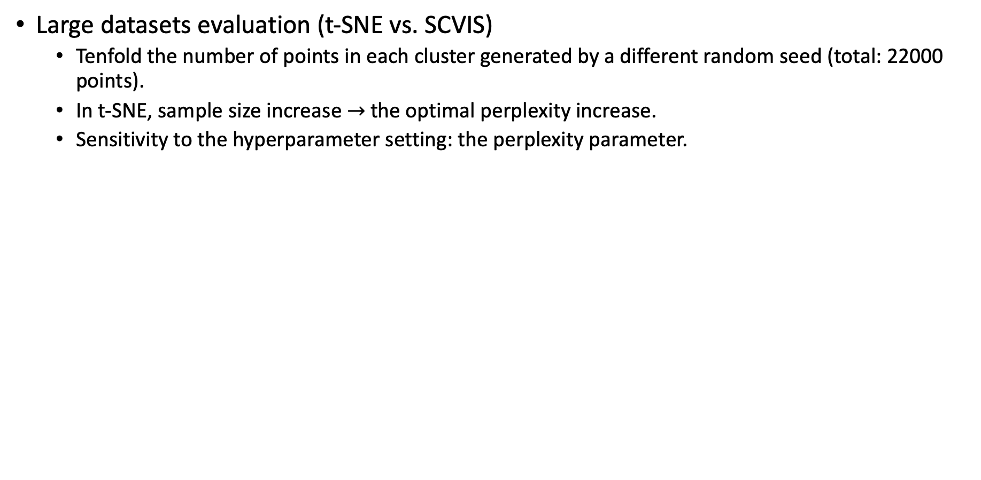
Simulation
Large datasets evaluation (t-SNE vs. SCVIS)
Tenfold the number of points in each cluster generated by a different random seed (total: 22000 points).
In t-SNE, sample size increase $→$ the optimal perplexity increase.
Sensitivity to the hyperparameter setting: the perplexity parameter.
Robust to the perplexity parameter.
(Sample size fixed (512) at each training step.)
Without perplexity adjustment
With perplexity adjustment
Hard to set this parameter in practice.

Slide 22
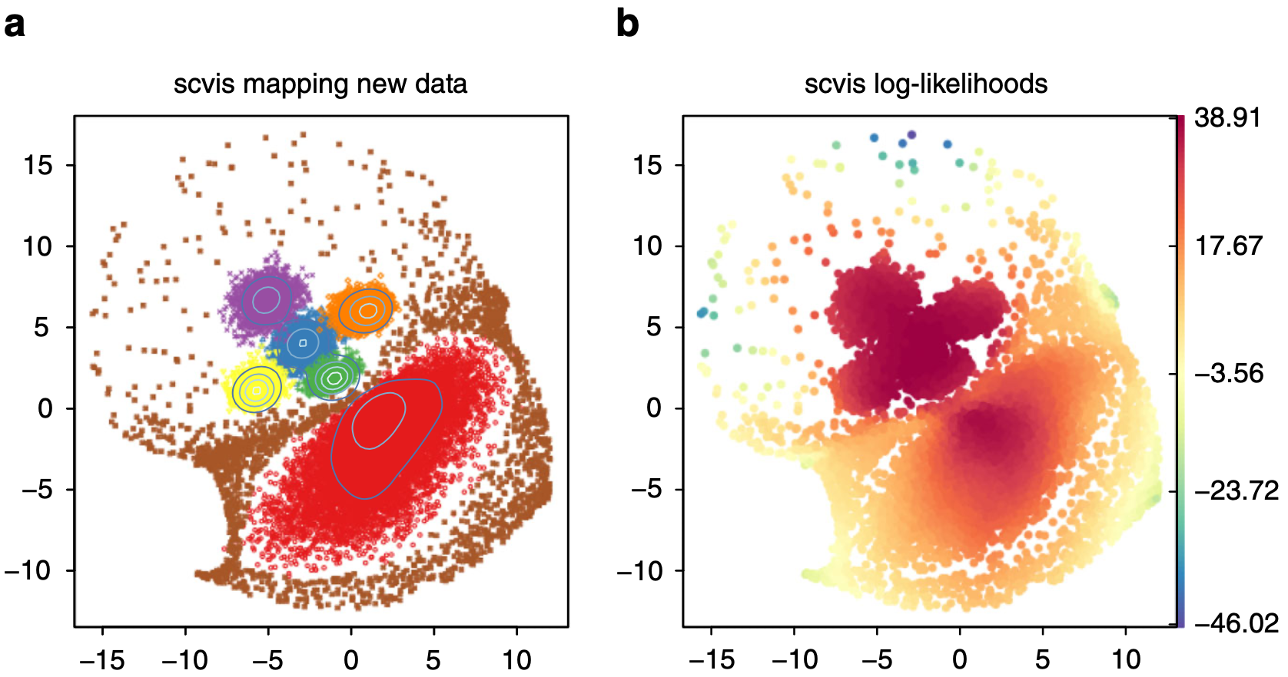
Simulation
Model performance on the new data embedding (SCVIS)
Use the original simulation model (based on the 2200 data points).
The SCVIS embedding result is similar to the original simulation data.
Original
data

Slide 23
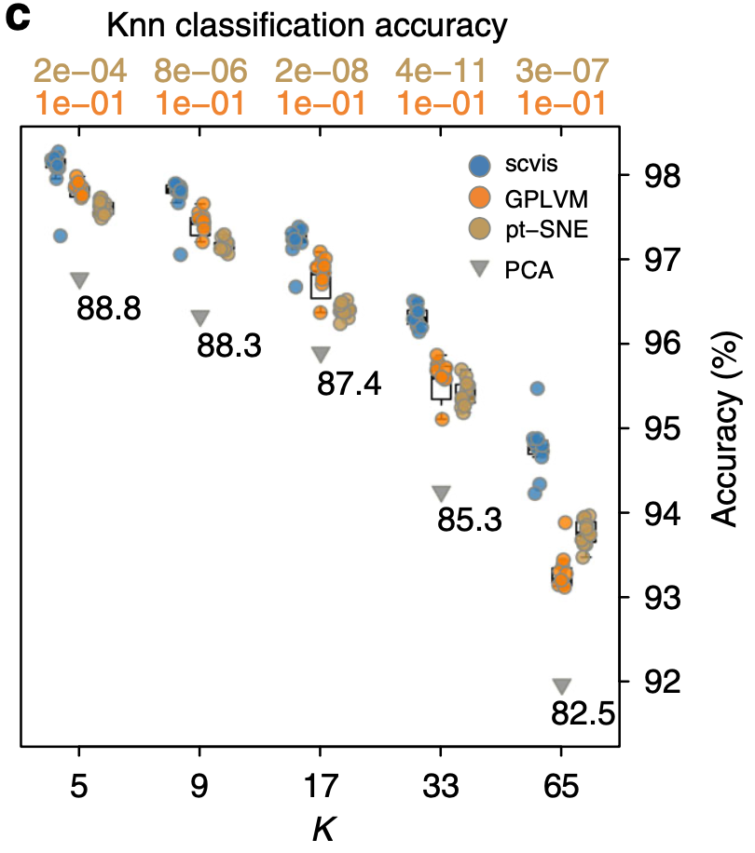
Simulation
Model performance on the new data embedding (pt-SNE, GPLVM, PCA, and SCVIS)
Train SCVIS, GPLVM, pt-SNE and KNN classifiers on the original 2200 simulated data.
Applied these trained models to the tenfold dataset (22000 simulated data.)
SCVIS performs significantly better for different Ks.
For a larger K, SCVIS assigns the outliers to the six genuine clusters (performance decrease).
PCA is worse than other methods.

Slide 24
Real Data Analysis
(Single-cell datasets)

Slide 25
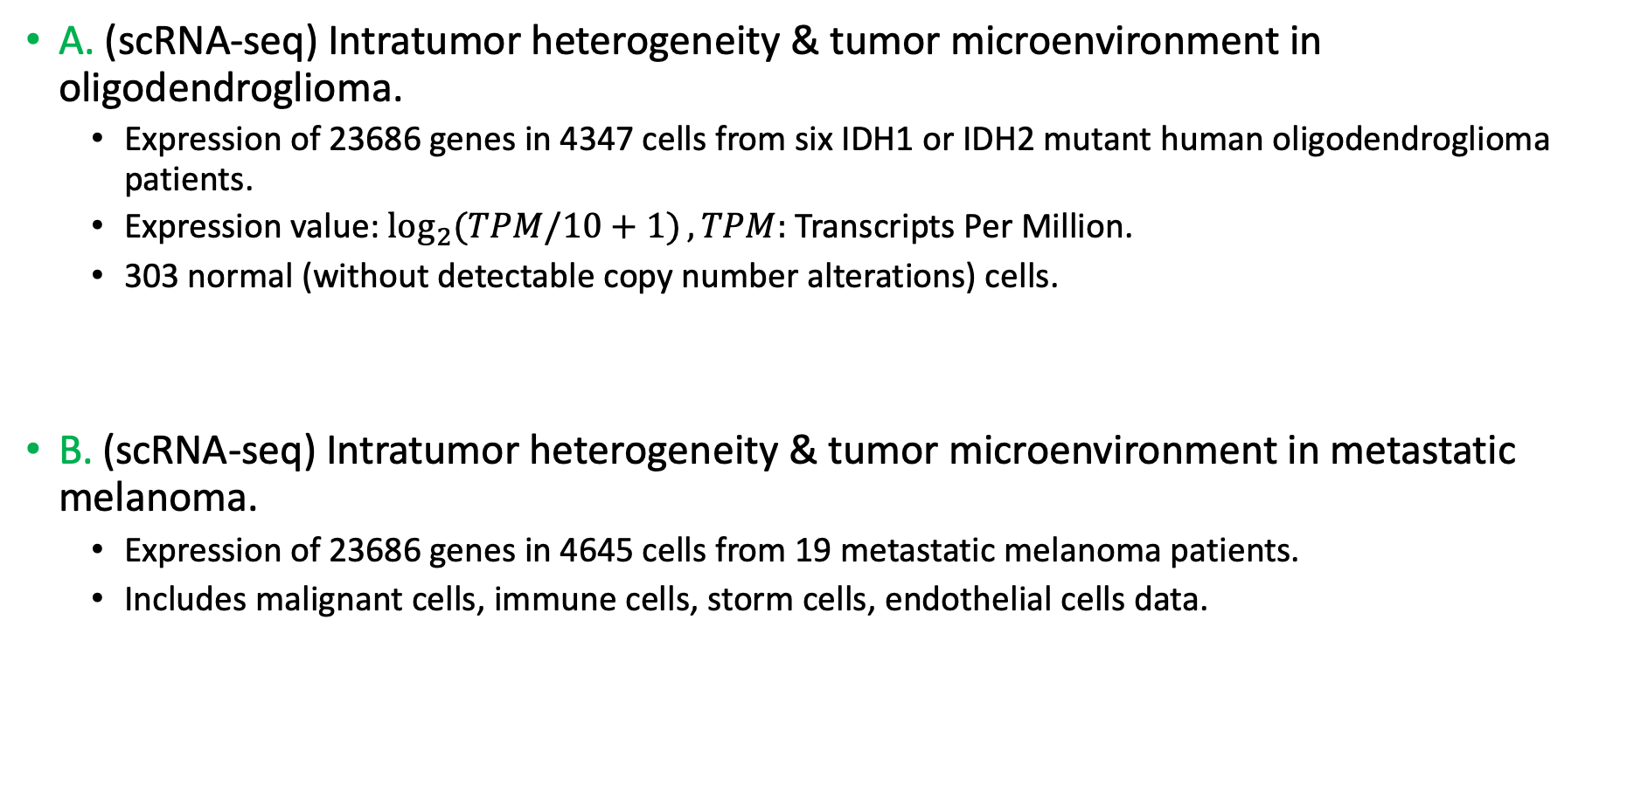
Single-cell Datasets
A. (scRNA-seq) Intratumor heterogeneity & tumor microenvironment in oligodendroglioma.
Expression of 23686 genes in 4347 cells from six IDH1 or IDH2 mutant human oligodendroglioma patients.
Expression value: $\log_{2}{(TPM/10+1)}, TPM:$ Transcripts Per Million.
303 normal (without detectable copy number alterations) cells.
B. (scRNA-seq) Intratumor heterogeneity & tumor microenvironment in metastatic melanoma.
Expression of 23686 genes in 4645 cells from 19 metastatic melanoma patients.
Includes malignant cells, immune cells, storm cells, endothelial cells data.

Slide 26
Single-cell Datasets
C. (scRNA-seq) The mouse bipolar cell populations of the retina.
27499 mouse retinal bipolar neural cells from a transgenic mouse.
26 putative cell types were identified by clustering the first 37 principal components of all 27499 cells.
15 clusters (96% of 27499 cells)
14 clusters: Bipolar cells
1 cluster: Muellerglia cells
11 clusters (1060 cells)
D. (scRNA-seq) All cell types in the mouse retina.
44808 cells from the retinas of 14-day-old mice.
39 clusters were identified using DBSCAN based on the two-dim t-SNE embedding.
For all the scRNA-seq datasets, use PCA to reduce the data into 100-dimensional space, and use the projected data as inputs to scvis.

Slide 27
Single-cell Datasets
Mass cytometry (CyTOF) datasets consists of bone marrow mononuclear cells from two healthy men H1 & H2.
E. Manually assigned 72463 cells to 14 cell types based on 32 measured surface protein markers on H1.
F. Manually assigned 31721 cells to 14 cell types based on 32 measured surface protein markers on H2.
For CyTOF dataset, use the original data as inputs to scvis.
10X Genomics neural cells datasets from two mice.
1306127 cells from cortex, hippocampus, and subventricular zones of two E18 C57BL/6 mice.

Slide 28
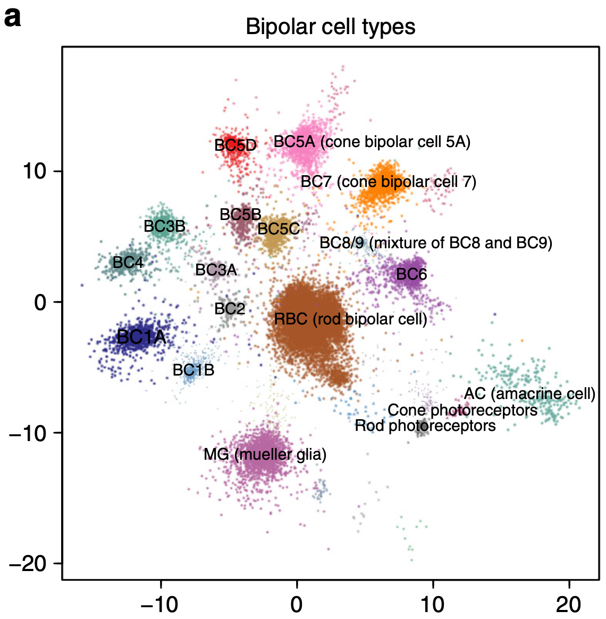
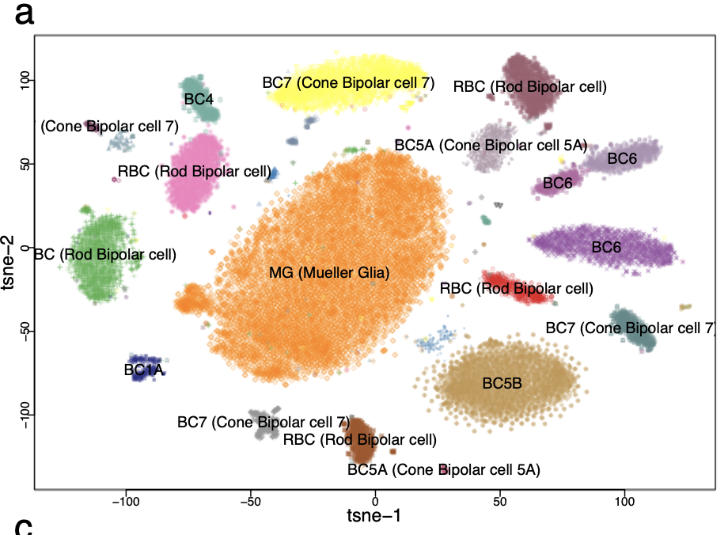
Real Data Analysis
Performance on a parametric mapping for a single-cell dataset (C. and D.)
Trained SCVIS model on the C. dataset and map the D. dataset.
Performance on the training data:
SCVIS
SCVIS mapped the cell doublets and contaminants into the low-density region in the low-D region.
Unlike SCVIS, t-SNE put the “outlier” cell doublets and contaminates into distinct compact cluster.
t-SNE cannot preserve global information.
“ON” cone bipolar cells
t-SNE
“OFF” cone bipolar cells
Non-bipolar cells

Slide 29
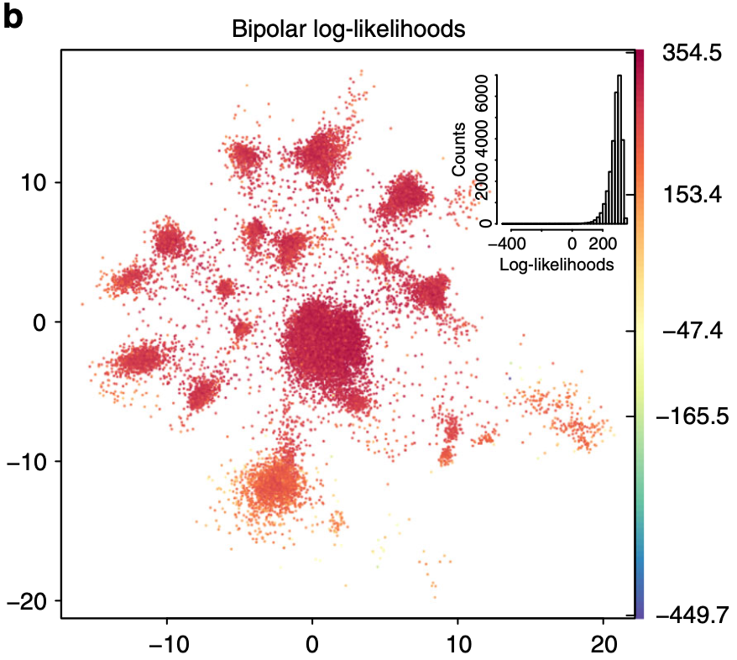
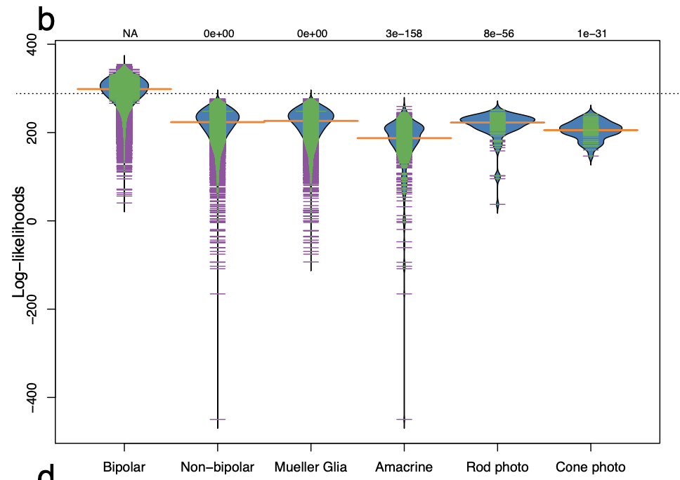
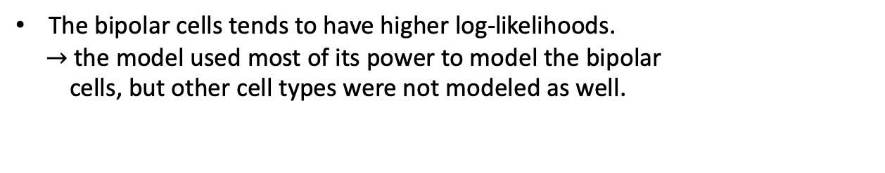
Real Data Analysis
Performance on a parametric mapping for a single-cell dataset (C. and D.)
Performance on the training data:
The bipolar cells tends to have higher log-likelihoods.
$→$ the model used most of its power to model the bipolar
cells, but other cell types were not modeled as well.
The amacrine cells had the lowest median log-likelihood.

Slide 30
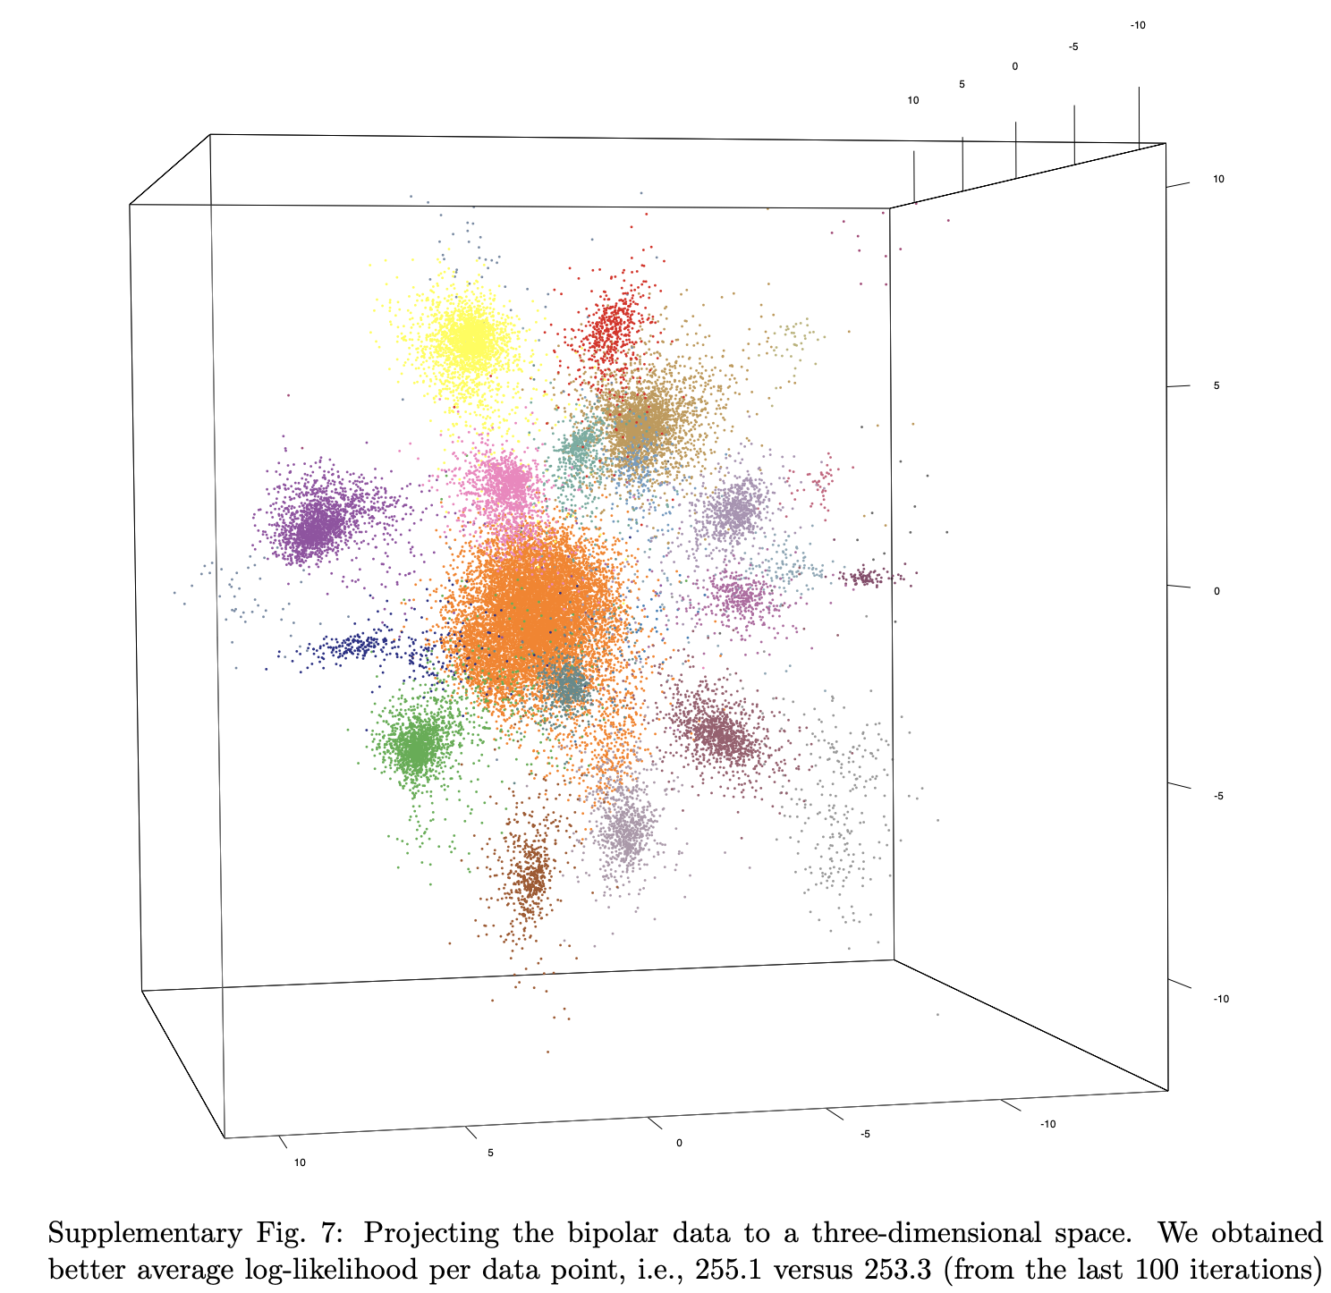
Real Data Analysis
Performance on a parametric mapping for a single-cell dataset (C. and D.)
Performance on the training data:
Project the C. data to a three-dimensional space.
Obtained a better average log-likelihood per data point and smaller KL divergence.

Slide 31
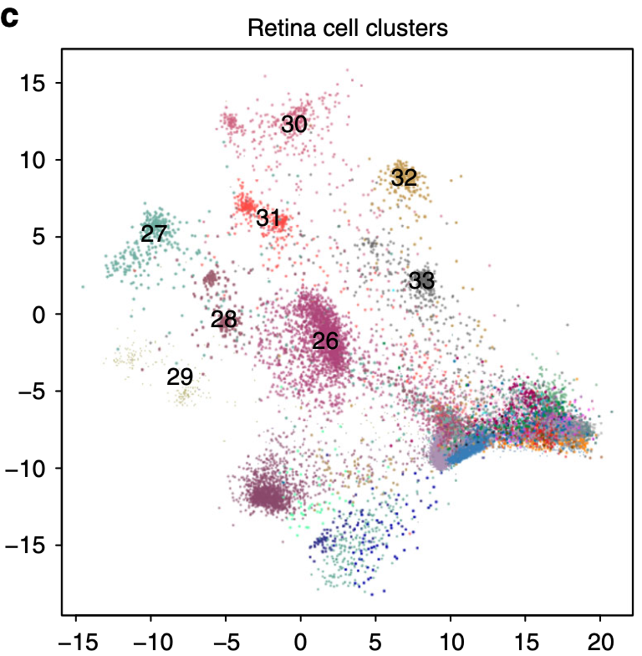
Real Data Analysis
Performance on a parametric mapping for a single-cell dataset (C. and D.)
Use PCA to project the D. dataset to the subspace of the first 100 principal component of the C. dataset.
Use the model trained on the C. dataset to map the D. dataset into two-dimensional space.
Performance on the D. data:
Tends to map data with the layout learned in the training data (C.)
Recently 14 subtypes of bipolar cells were present in this dataset.
The mixture of bipolar cells data should be further investigated.
BC5A & BC5D
BC6 & BC8/9
BC3B & BC4
BC5B & BC5C
BC3A & BC2
BC31A & BC1B

Slide 32


Real Data Analysis
Performance on a parametric mapping for a single-cell dataset (C. and D.)
Performance on the D. data:
The mixture of bipolar cells data had lower log-likelihoods.
As in the C. data, the bipolar cells in the D. data tend to have high log-likelihood.
The bipolar cells in the mixture cluster were substantially different from other bipolar cells. (by KNN classifiers result.)

Slide 33


Real Data Analysis
Performance on the tumor microenvironments and intratumor heterogeneity (A. and B.)
A dataset consists of mostly malignant cells (includes oligodendrocyte, astrocyte, and stem-like cells).
15 clusters are found by using densitycut based on the SCVIS embedding.
Non-malignant cells
Stem-like cells, with cycling
Entropy is based on the cells of origins (a).
High entropy: #1, #5, #12, #14, #15
Malignant cells formed distinct clusters even if they were from the same patient.
Astrocyte
Colored by its patient of origin

Slide 34


Real Data Analysis
Performance on the tumor microenvironments and intratumor heterogeneity (A. and B.)
A dataset embedding result colored by lineage score.
Cells in some clusters highly expressed the astrocyte gene markers or the oligodendrocyte.
The stem-like cells tends to be rare and could link outliers connecting oligodendrocyte and astrocyte cells.
Some clusters consisted of mixture of cells
$→$ other factors (e.g. genetic mutation and epigenetic
measurements) would be required to interpret the
clustering structures furtherly.
Colored by its linage score

Slide 35



Real Data Analysis
Performance on the tumor microenvironments and intratumor heterogeneity (A. and B.)
B dataset consists malignant and non-malignant cells.
Non-malignant immune cells (B cells, T cells) tend to be grouped together by cell types instead of patients of origin of cells.
Some non-malignant cells (CAFs) were map to the region adjacent to the malignant cells (Endothelial). $→$ CAFs and endothelial cells were truly more similar to malignant cells (by a hierarchical clustering analysis).
Some immune cells of some patients showed patient-specific bias (#75, #58, #67) $→$ Batch effect between patient 75 and other patient.
Endothelial
#75
#58
CAFs
#67
Colored by its cell type
Colored by its patient of origin

Slide 36


Real Data Analysis
Performance on other types of single-cell data (E. and F.)
Learn the parametric mapping from the F. data and apply on the E. data (project into two-dimensional space.)
All the 14 cell types were separated and CD4 T cells & CD8 T cells are adjacent to each other.
The high quality of the mapping carried over on the H1 data.
H2
H1

Slide 37
Summary

Slide 38
Summary
SCVIS is developed for modeling and reducing dimensionality of single-cell gene expression data.
SCVIS provides:
A low-D embeddings of high-D data while preserving global structure of the high-D measurements.
The log-likelihood as a measure of the quality (uncertainty) of the embedding.
Detecting outliers.
An indicator of further analysis for adjacent/overlapping region.
Compare with other methods, SCVIS can generate a non-linear and interpretable result at the same time.

Slide 39
Appendix

Slide 40

Variational Autoencoder (VAE)
Some important property
Generate a linear combination of current datapoints in the database.
Provide a buffer area (sigma of $ε$) in estimating current image. (Autoencoder does not provide this buffer.)

Slide 41

Variational Autoencoder (VAE)
The Derivation from the Variational Inference
Model evidence$=log L\left(θ,X_{n}\right)=\log{P\left(X_{n}; θ\right)}$
$=\int{q\left(Z_{n}\right)dZ_{n}}∙logP\left(X_{n};θ\right)=\int{q\left(Z_{n}\right)logP\left(X_{n};θ\right)dZ_{n}}$
$=\int{q\left(Z_{n}\right)\log\left[\frac{P\left(X_{n};θ\right)∙q\left(Z_{n}\right)}{P\left(X_{n}, Z_{n};θ\right)}∙\frac{P\left(X_{n}, Z_{n};θ\right)}{P\left(Z_{n}\right)}∙\frac{P\left(Z_{n}\right)}{q\left(Z_{n}\right)}\right]dZ_{n}}$
$=\int{q\left(Z_{n}\right)∙\left[log\left[\frac{P\left(X_{n};θ\right)∙q\left(Z_{n}\right)}{P\left(X_{n}, Z_{n};θ\right)}\right]+log\left[\frac{P\left(X_{n}, Z_{n};θ\right)}{P\left(Z_{n}\right)}\right]+log\left[\frac{P\left(Z_{n}\right)}{q\left(Z_{n}\right)}\right]\right]dZ_{n}}$
$=\int{q\left(Z_{n}\right)∙\left[−log\left[\frac{P\left(X_{n}, Z_{n};θ\right)}{P\left(X_{n};θ\right)q\left(Z_{n}\right)}\right]+log\left[\frac{P\left(X_{n}, Z_{n};θ\right)}{P\left(Z_{n}\right)}\right]−log\left[\frac{q\left(Z_{n}\right)}{P\left(Z_{n}\right)}\right]\right]dZ_{n}}$
$=\int{q\left(Z_{n}\right)∙\left[log\left[\frac{P\left(X_{n}, Z_{n};θ\right)}{P\left(Z_{n}\right)}\right]−log\left[\frac{q\left(Z_{n}\right)}{P\left(Z_{n}\right)}\right]−log\left[\frac{P\left(Z_{n}|X_{n};θ\right)}{q\left(Z_{n}\right)}\right]\right]dZ_{n}}$
$=\int{q\left(Z_{n}\right)∙\left[log\left[\frac{P\left(X_{n}, Z_{n};θ\right)}{P\left(Z_{n}\right)}\right]−log\left[\frac{q\left(Z_{n}\right)}{P\left(Z_{n}\right)}\right]+log\left[\frac{q\left(Z_{n}\right)}{P\left(Z_{n}|X_{n};θ\right)}\right]\right]dZ_{n}}$
$=$ $\int{q\left(Z_{n}\right)∙log\left[\frac{P\left(X_{n}, Z_{n};θ\right)}{P\left(Z_{n}\right)}\right]dZ_{n}}−\int{q\left(Z_{n}\right)∙log\left[\frac{q\left(Z_{n}\right)}{P\left(Z_{n}\right)}\right]dZ_{n}}+\int{q\left(Z_{n}\right)∙log\left[\frac{q\left(Z_{n}\right)}{P\left(Z_{n}|X_{n};θ\right)}\right]dZ_{n}}$
$=E_{z\sim q}\left[logP\left(X_{n} | Z_{n};θ\right)\right]−KL\left[q\left(Z_{n}\right)||P\left(Z_{n}\right)\right]+KL\left[q\left(Z_{n}\right)||P(Z_{n}|X_{n};θ)\right]$

Slide 42

Variational Autoencoder (VAE)
The Reparametrized Trick in Math
${∇_{θ, φ}E}_{z\sim q_{φ}}\left[logP\left(X_{n} | Z_{n};θ\right)\right]=∇_{θ, φ}\int{logP\left(X_{n} | Z_{n};θ\right)q(Z_{n}|X_{n};φ)dZ_{n}}→$ It’s very difficult to compute because the integral is typically unknown and the parameters $φ$ are of the distribution $q\left(Z_{n} | X_{n};φ\right) (Z_{n} is stochastic).$ We cannot guarantee the result to be an expectation form under $Z_{n}$ which is $q\left(Z_{n} | X_{n};φ\right)$ distributed, and that cannot be approximated by the W.L.L.N and Monte Carlo Simulation later.
However, with the reparametrized trick,
$∇_{θ, φ}E_{ε\sim N(0, 1)}\left[logP\left(X_{n} | g\left(ε,X_{n},φ\right);θ\right)\right]=∇_{θ, φ}\int{logP\left(X_{n} | g\left(ε,X_{n},φ\right);θ\right)N(0,1)dε}$
$=\int{∇_{θ, φ}logP\left(X_{n} | g\left(ε,X_{n},φ\right);θ\right)N(0,1)dε}=E_{ε\sim N(0, 1)}\left[∇_{θ, φ}logP\left(X_{n} | g\left(ε,X_{n},φ\right);θ\right)\right]$
$→$ It then can be approximated by W.L.L.N and Monte Carlo Simulation.

